Slide 1

Raspberry Pi and OpenPLC
Dr. David J. Coe
Electrical and Computer Engineering Department
University of Alabama in Huntsville
coed@uah.edu

Slide 2
Outline
Introduction to Raspberry Pi
Raspberry Pi Preparation
OpenPLC Installation on Raspberry Pi
Sample OpenPLC - Raspberry Pi Project
Hints for Instructors
References
Hands-On Laboratory Exercise #5

Slide 3
Introduction to Raspberry Pi

Slide 4
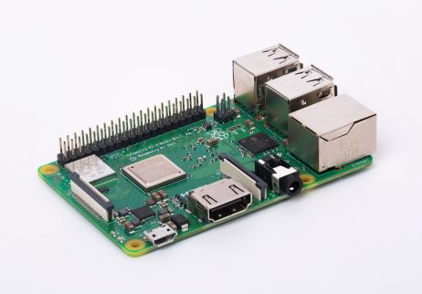
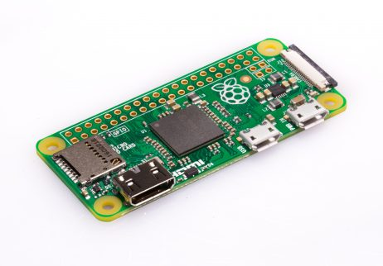
What is a Raspberry Pi?
Family of low cost, single-board computers targeted at education
Linux-based operating system called Raspbian OS
Many models that differ by processing capabilities, memory, wired and wireless interfaces provided
Often sold as part of a kit which may include a case, power supply, and other accessories such as a camera or prototyping breadboard
$10 Raspberry Pi Zero
$35 Raspberry Pi 3 B+
https://www.raspberrypi.org

Slide 5
What can you do with a Raspberry Pi?
Learn computer programming
Example: Python, C, C++, and more!
Learn about robotics and autonomous vehicles
Example: Donkey Car open source self-driving vehicle
https://www.donkeycar.com/
Learn image processing
Example: OpenCV – Open Computer Vision
https://www.learnopencv.com/install-opencv-4-on-raspberry-pi/
Learn about machine learning
Example: Google’s Tensorflow machine learning tools
https://www.tensorflow.org/install/source_rpi
Learn about cybersecurity
Example: Kali Linux and its suite of cybersecurity tools
https://www.offensive-security.com/kali-linux-arm-images/
Learn about Programmable Logic Controllers (PLCs) and Cybersecurity
Example: OpenPLC Project by Thiago Alves
https://www.openplcproject.com/

Slide 6
Raspberry Pi 3 B+ Preparation

Slide 7
Before Connecting Power to the Raspberry Pi 3 B+
Warning:
If you are using the bare Raspberry Pi board without a case, be sure the board is NOT on a conductive surface when you connect the power supply or else…
You may shock yourself if you are touching the conductive surface when you connect power to the Pi
You may destroy your Raspberry Pi board by short circuiting wire traces on the board
I recommend purchase of a plastic case for your Raspberry Pi board to protect both you and the Pi

Slide 8
Before You Disconnect Power to the Raspberry Pi
Warning:
Be sure to properly shutdown your Raspberry Pi prior to unplugging the power cord
If not, you may corrupt the microSD card which will force you to rebuild the entire file system starting with installation of a clean copy of the Raspbian OS image onto the microSD card itself and a reinstall of OpenPLC
I recommend using the Shutdown menu option on the Raspberry Pi desktop interface and waiting a few minutes before unplugging the power supply cord
Hints:
Backup any OpenPLC programs you wish to keep before shutdown – just in case
Use the Linux (secure copy) utility scp
On my setup, I wait until the monitor no longer thinks its connected to a computer and the last lights on the Pi stop blinking before I unplug the Pi power supply

Slide 9
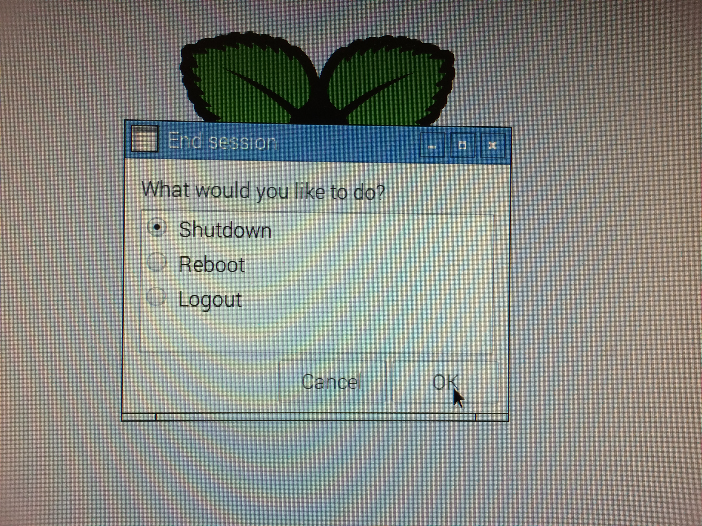
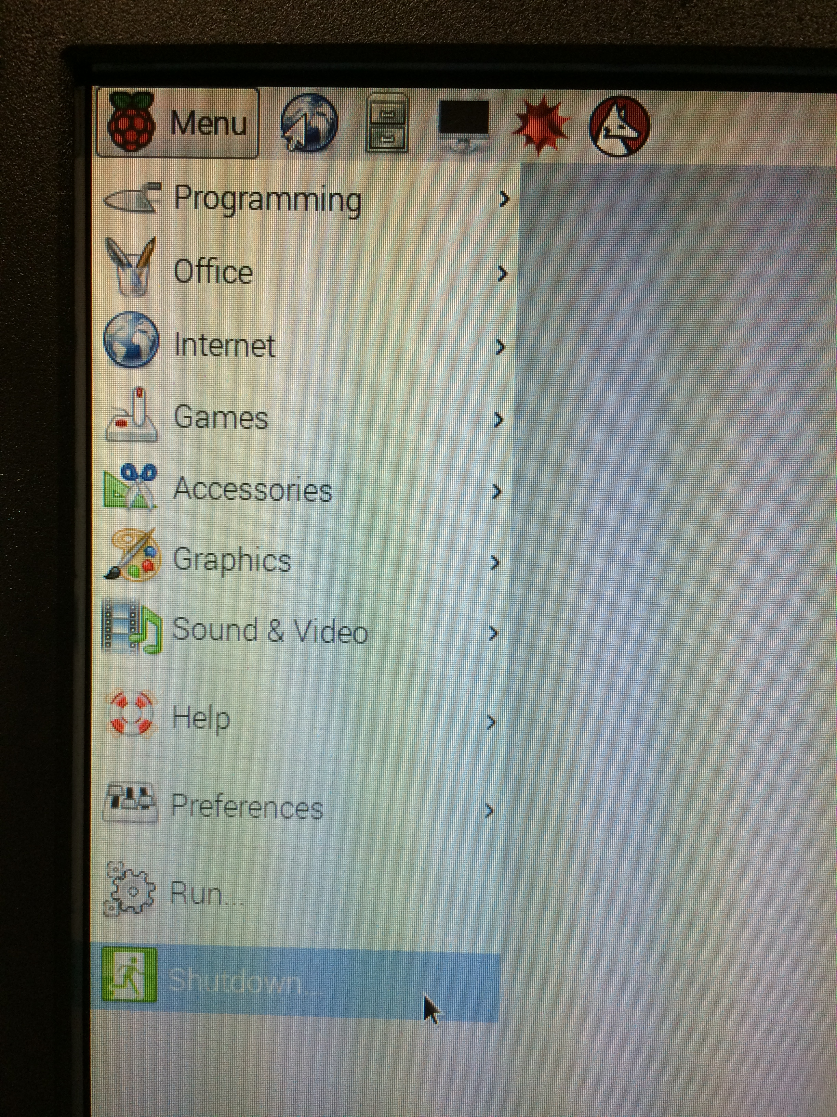
Before You Disconnect Power to the Raspberry Pi

Slide 10
Preparation: Acquire a Raspberry Pi 3 B+ Kit
My Raspberry Pi 3 B+ kit included a microSD card with a preloaded Raspbian OS image
Many sources for Raspberry Pi kits
Sparkfun Electronics ( https://www.sparkfun.com )
Adafruit ( https://www.adafruit.com )
CanaKit ( https://www.canakit.com )
Be sure the kit includes a case and a power supply at minimum
To use the Raspberry Pi as a PLC, it will need to interface with physical world sensors and actuators
Select a case that provides access to the 40-pin connector
Hint:
In addition to the Pi board, case, and power supply, get a kit that includes a prototyping board, ribbon cable, a breakout board for the 40-pin connector, and a selection of circuit components (resistors, capacitors, jumper wires, pushbutton switches, etc.)

Slide 11
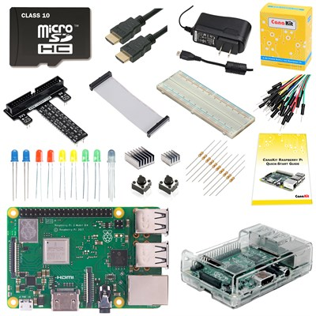
Photo: My Raspberry Pi 3 B+ Kit
https://www.canakit.com/raspberry-pi-3-model-b-plus-ultimate-kit.html

Slide 12
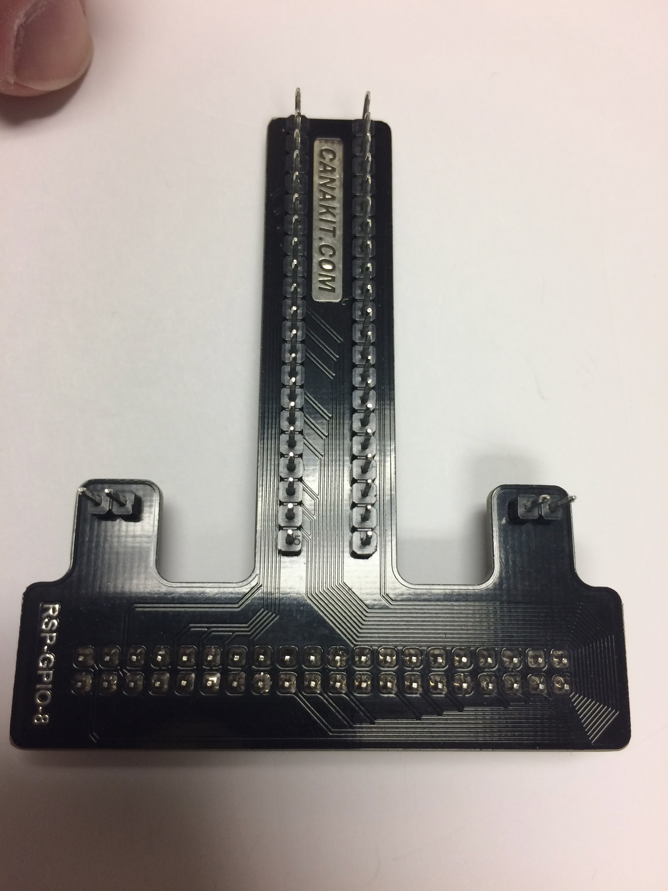
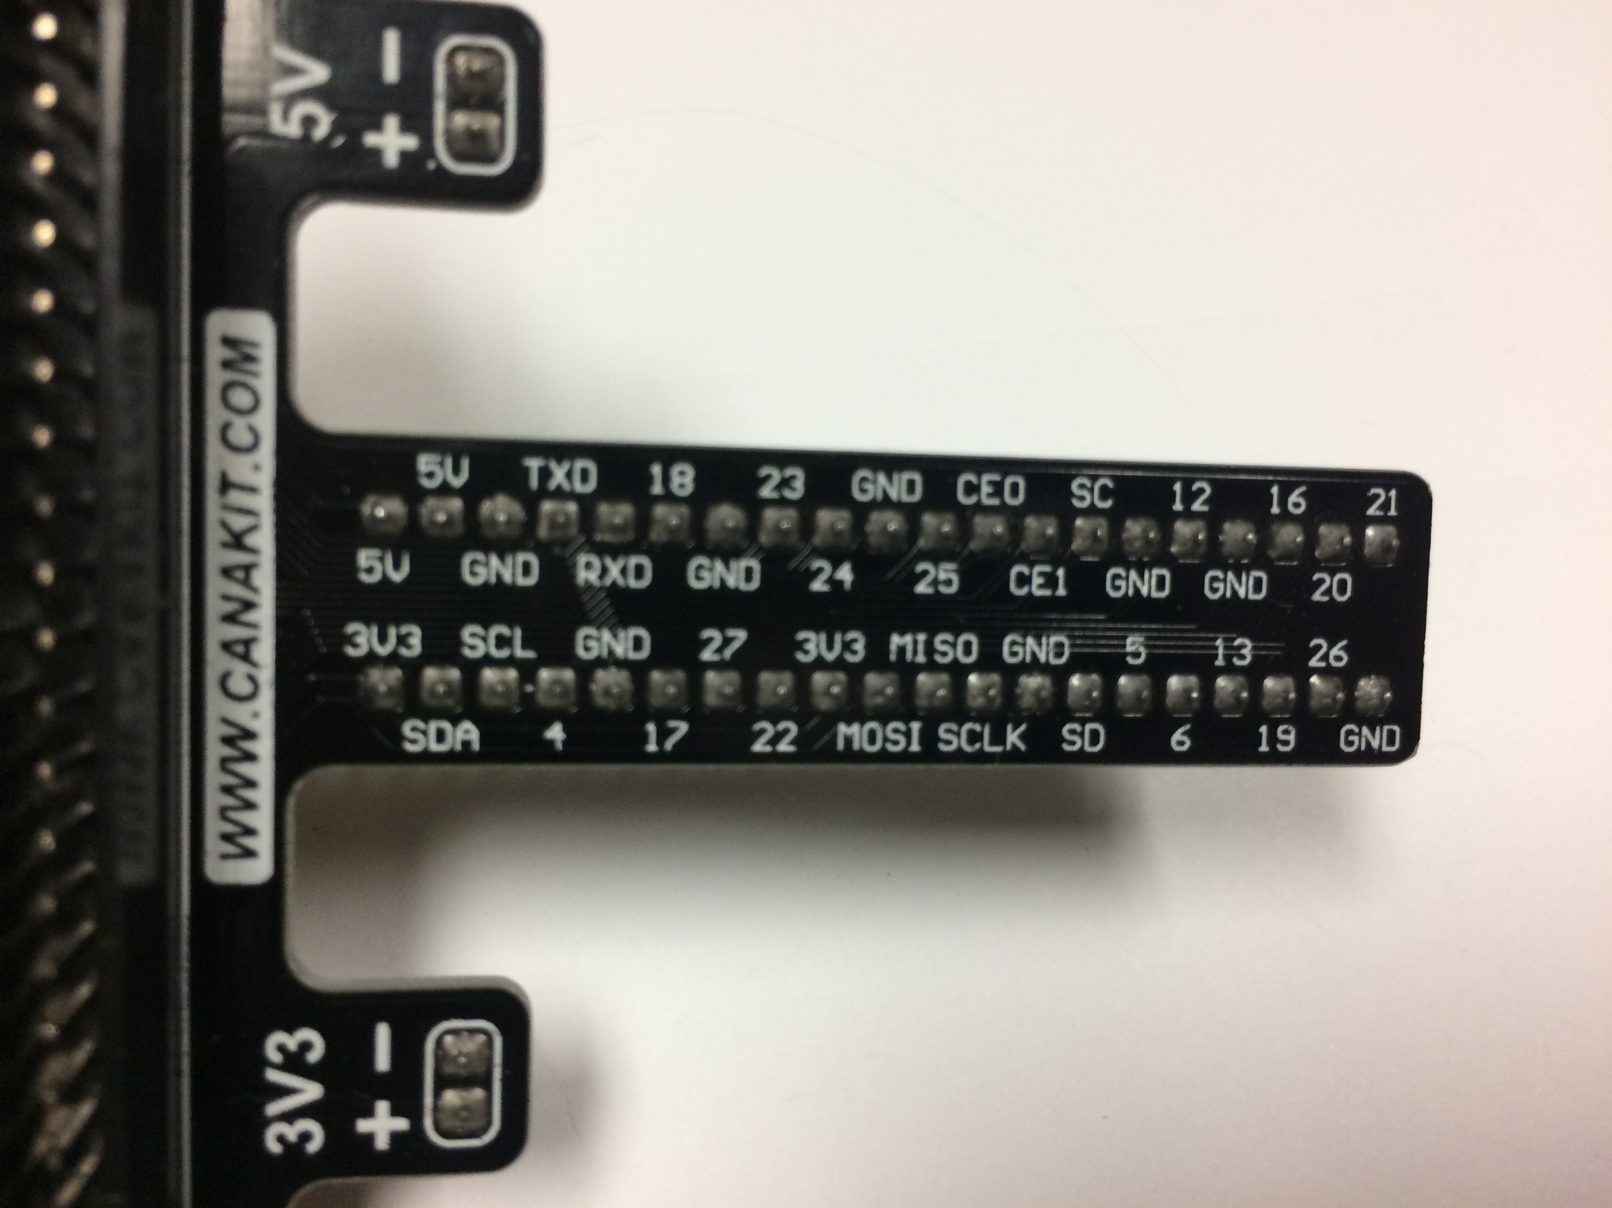
Photo: Raspberry Pi 3 Breakout Board
Front
Back

Slide 13
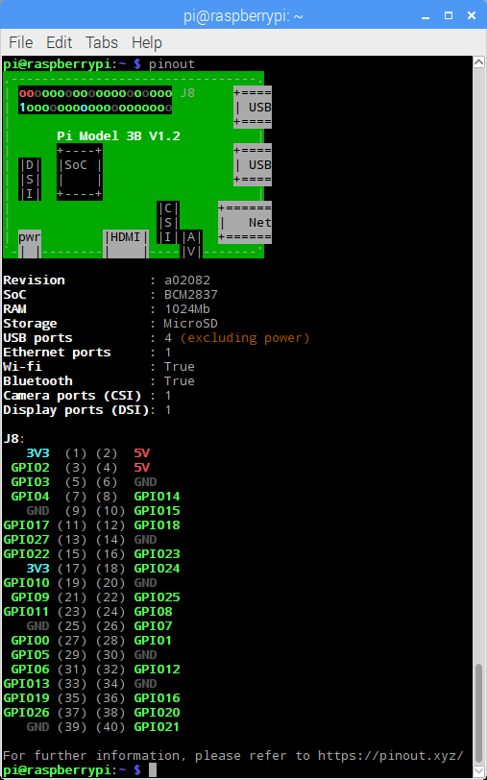
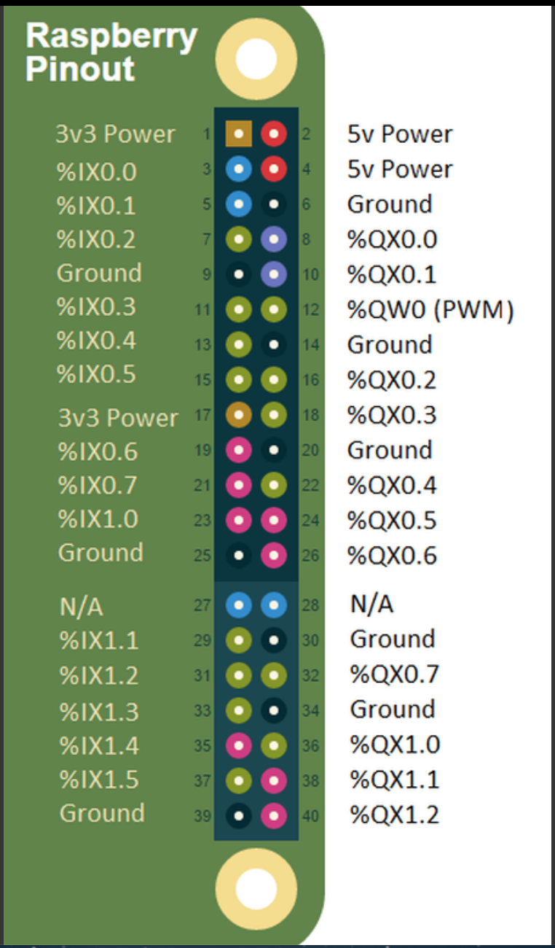
OpenPLC Pinout
https://www.openplcproject.com/getting-started-rpi
https://www.raspberrypi.org/documentation/usage/gpio/

Slide 14
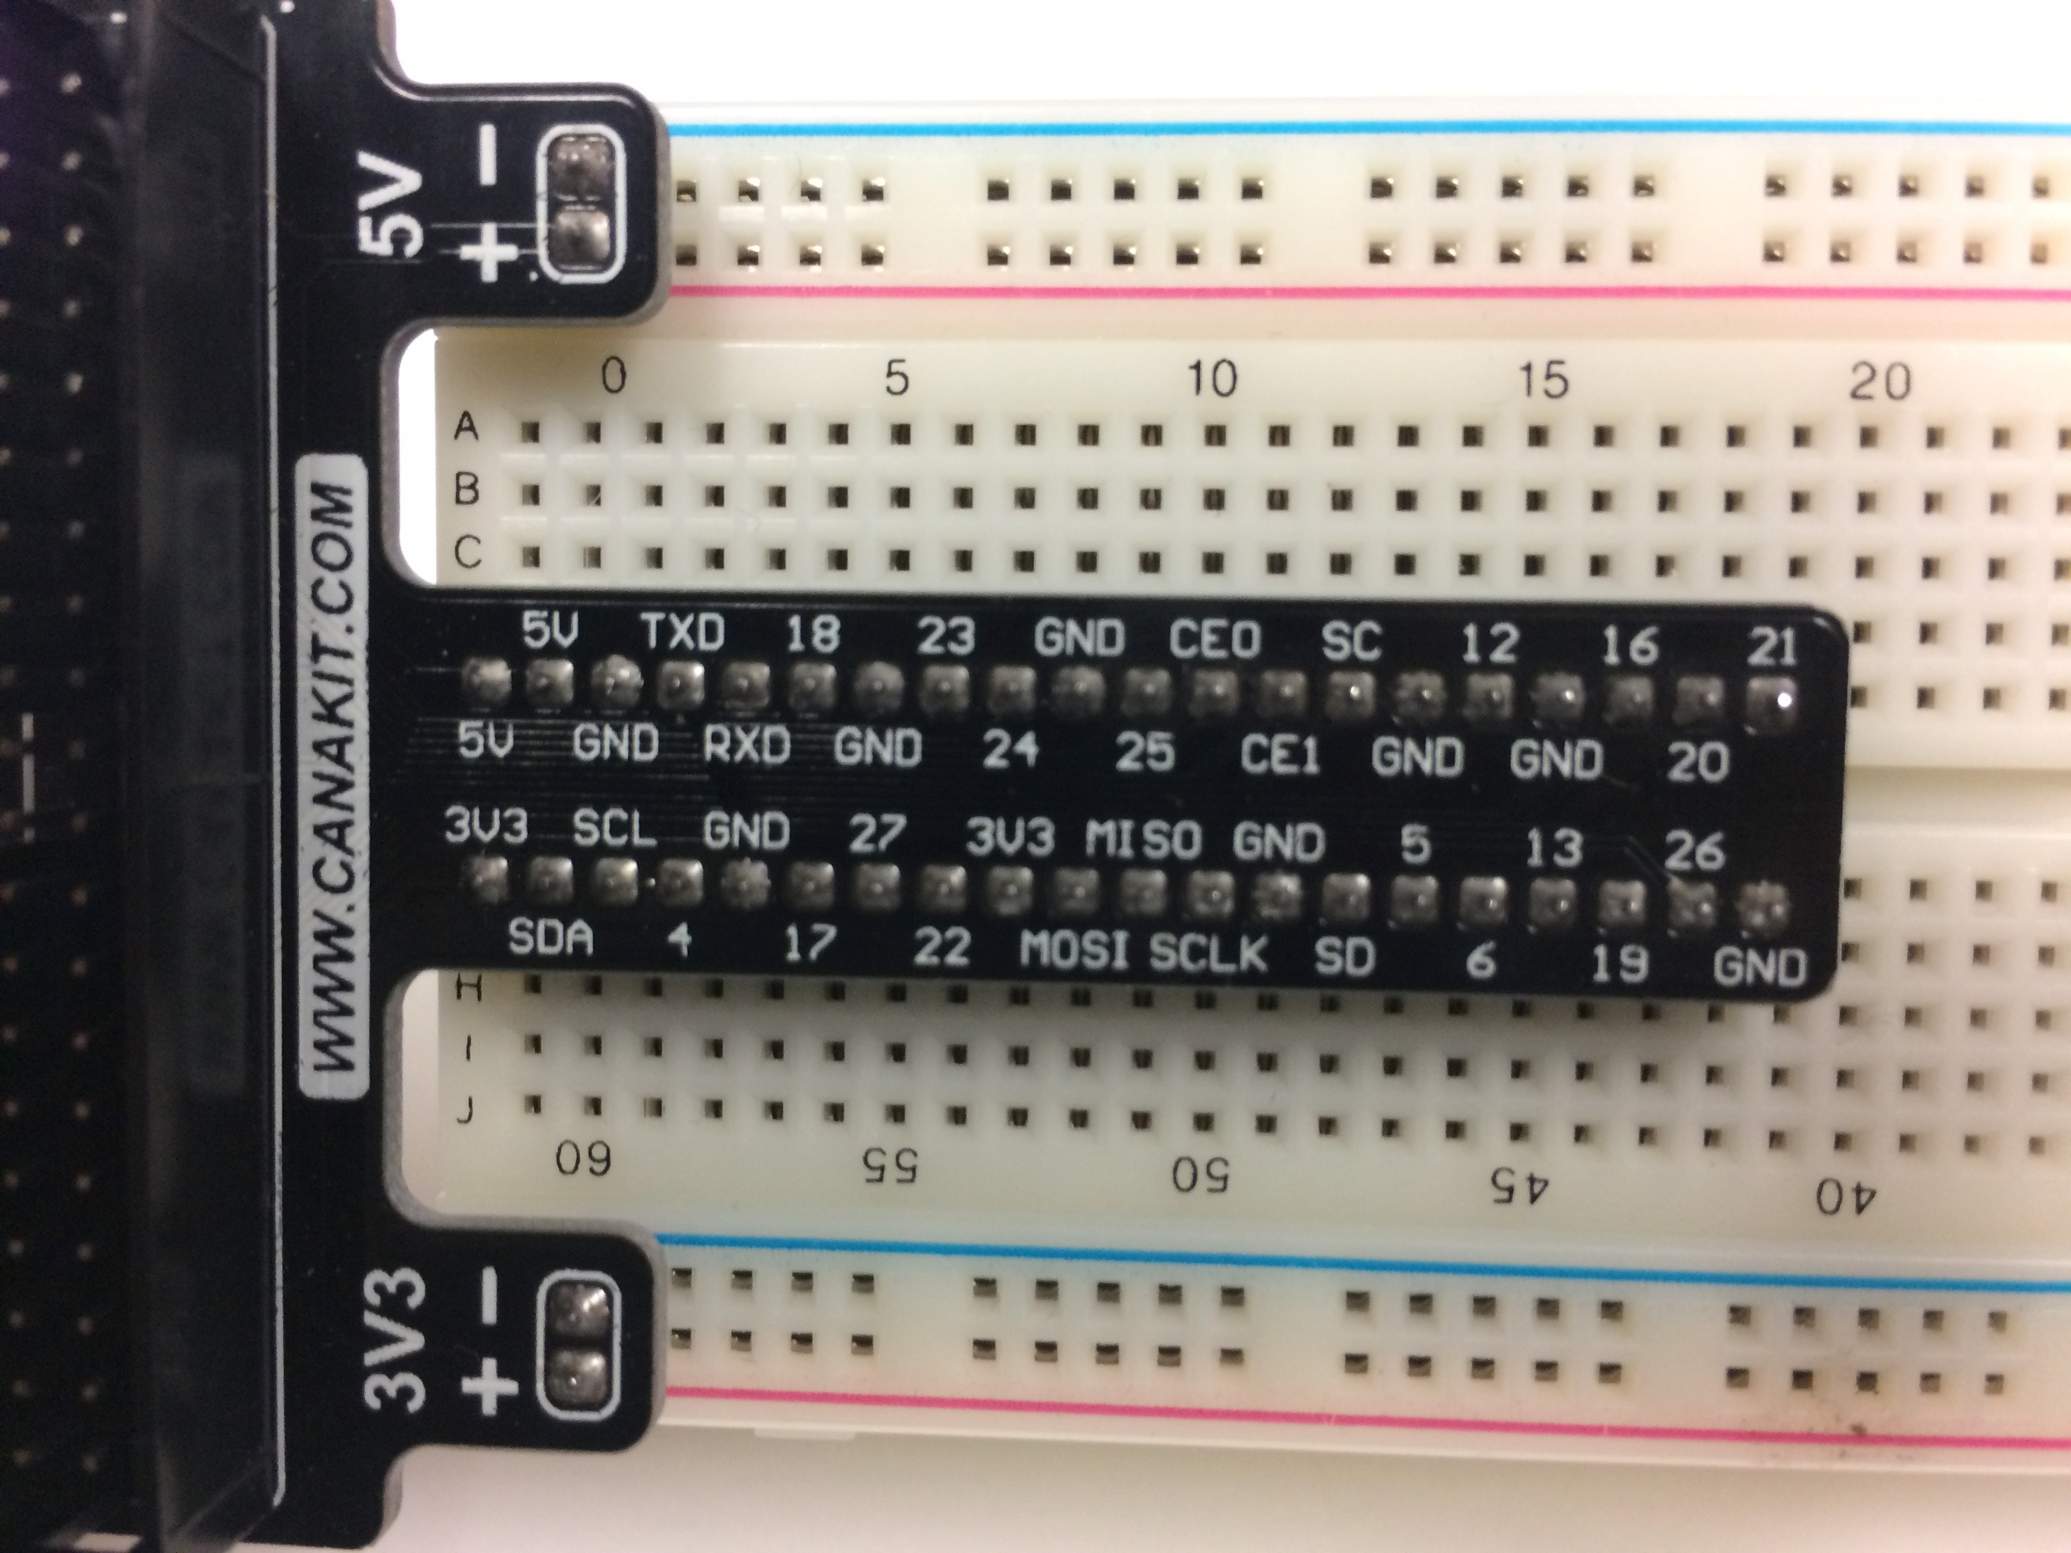
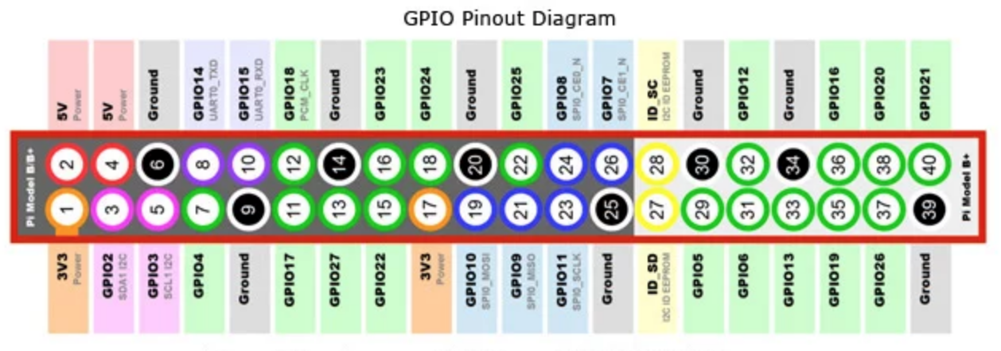
Photo: Breakout Board on Prototyping Breadboard
https://www.openplcproject.com/getting-started-rpi
https://www.jameco.com/Jameco/workshop/circuitnotes/raspberry-pi-circuit-note.html

Slide 15
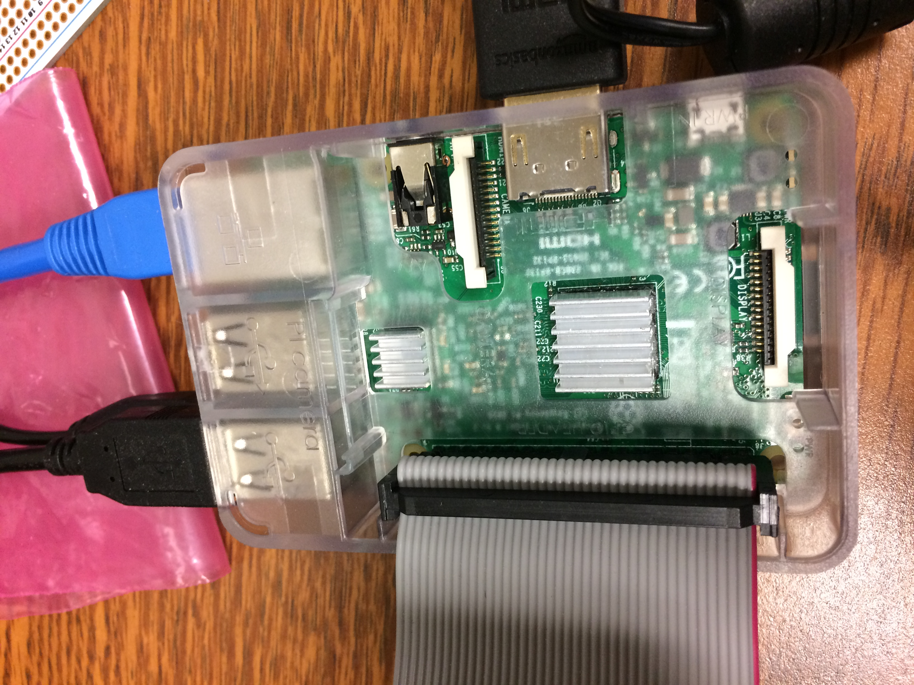
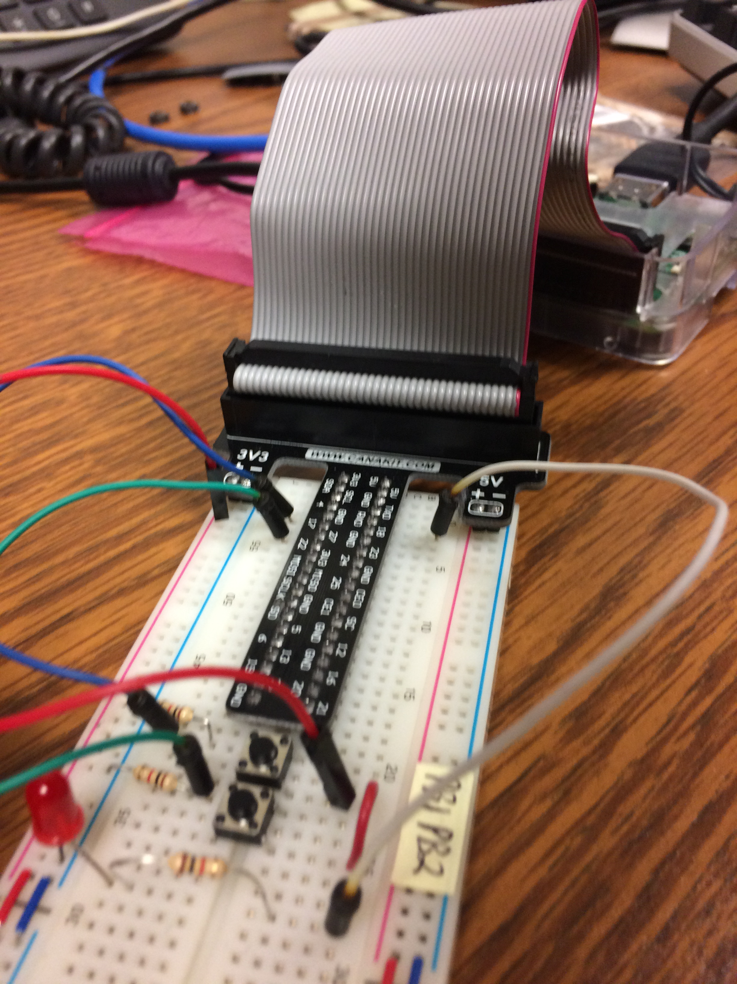
Connect Raspberry Pi 3 to Breakout Board
Ribbon cable to Raspberry Pi
Ribbon cable to breakout board
Ribbon cable keyed for plug in to breakout board
Align red wire of ribbon cable to pin #1 on Raspberry Pi 3B+ header

Slide 16
Preparation: Boot Your Raspberry Pi 3 B+
Add a keyboard, monitor, and mouse
You will need a keyboard, monitor, and mouse to configure WiFi network
Install the microSD card in the card slot
If the Raspberry Pi is not in a case, be sure it is not on a conductive surface
Plug in power supply to wall power
Hook power supply to Raspberry Pi
Wait for Raspberry Pi to boot – you should see the Raspbian OS graphical desktop

Slide 17
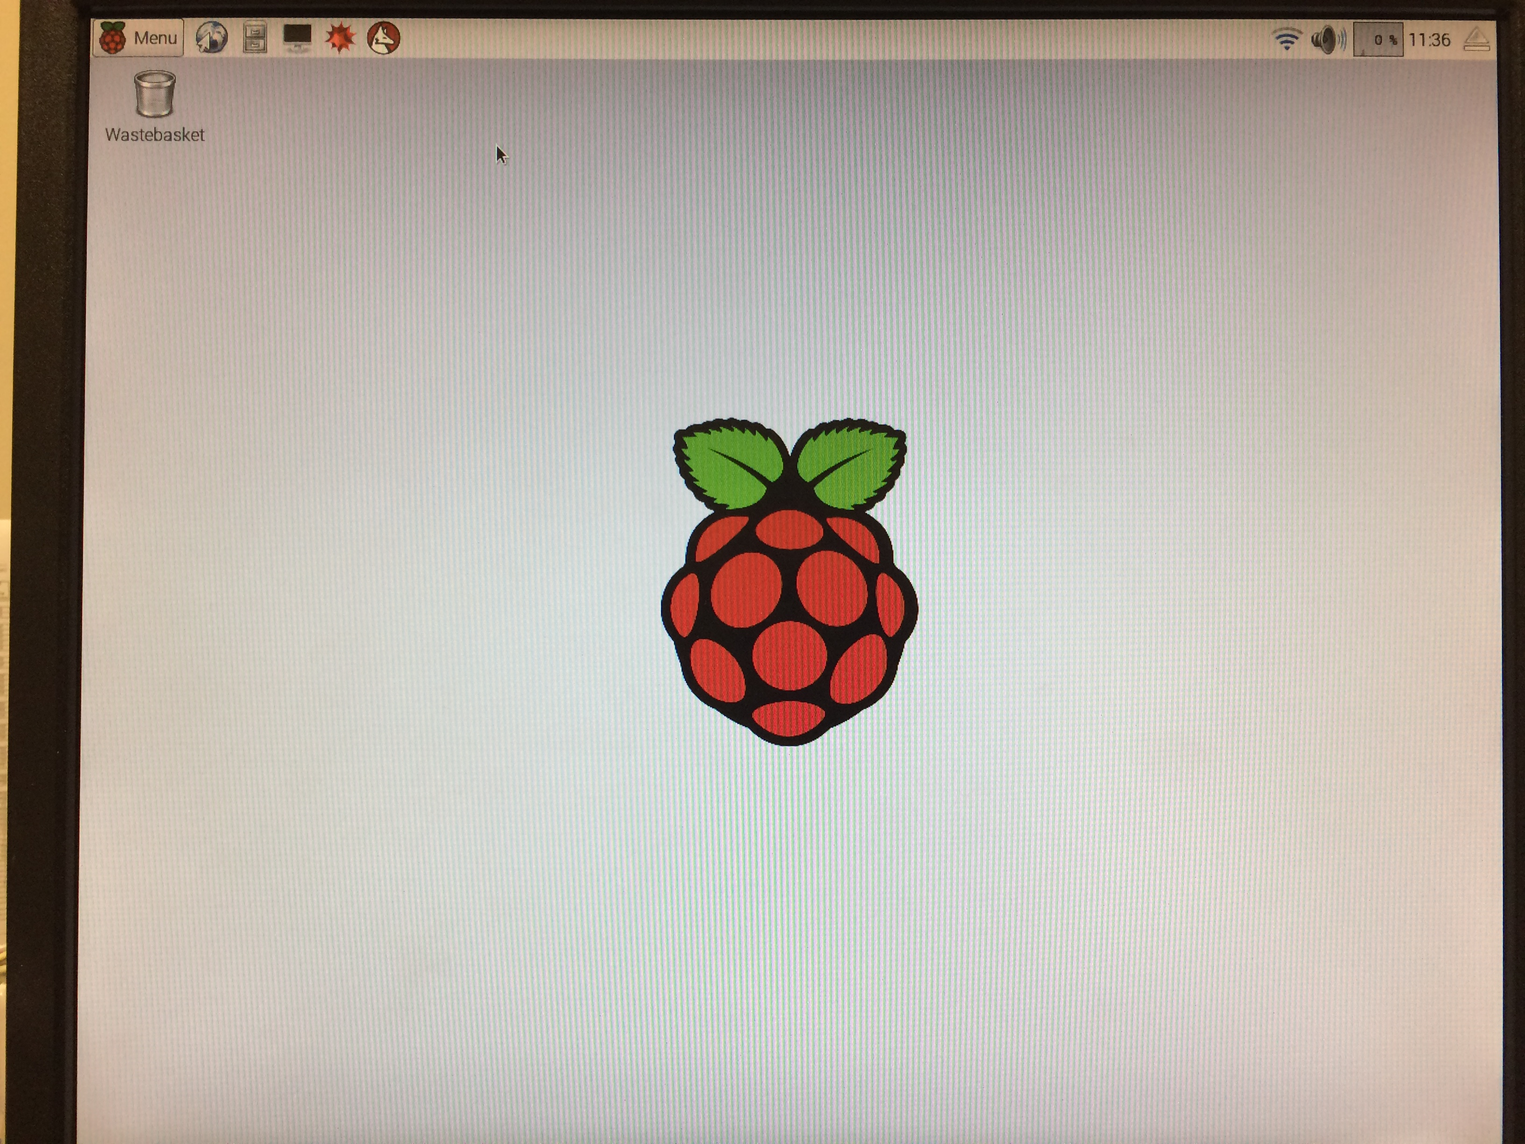
Booted Raspberry Pi 3 B+

Slide 18
Preparation: Boot the Raspberry Pi 3 B+
The default credentials for logging into the Raspberry Pi are
Username: pi
Password: raspberry
These credentials are so common they already appear in Kali wordlists of common credentials for brute-force attacks
➔ Change your password!!!

Slide 19
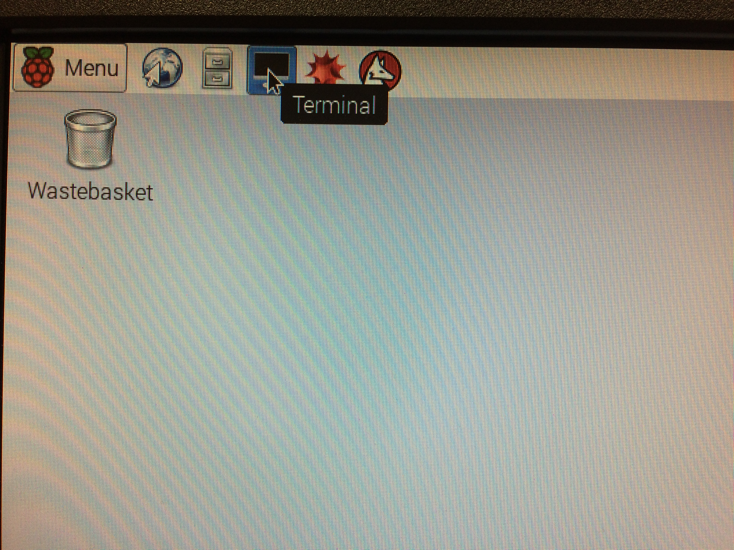
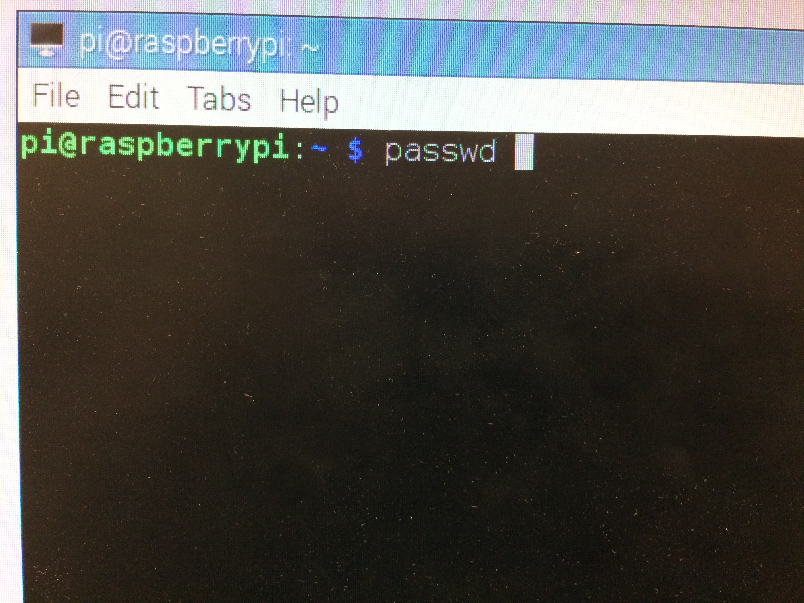
Open Terminal Window to Change Password
Use standard Linux passwd command to change password

Slide 20
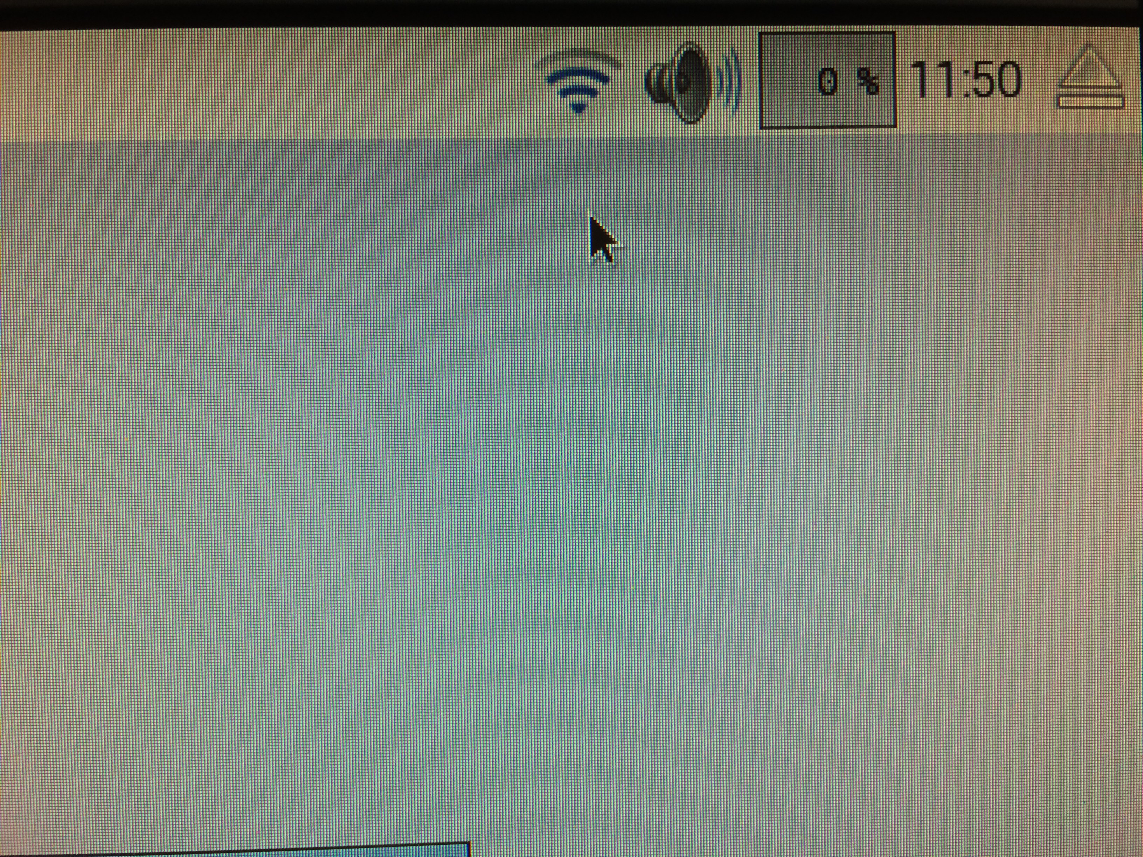
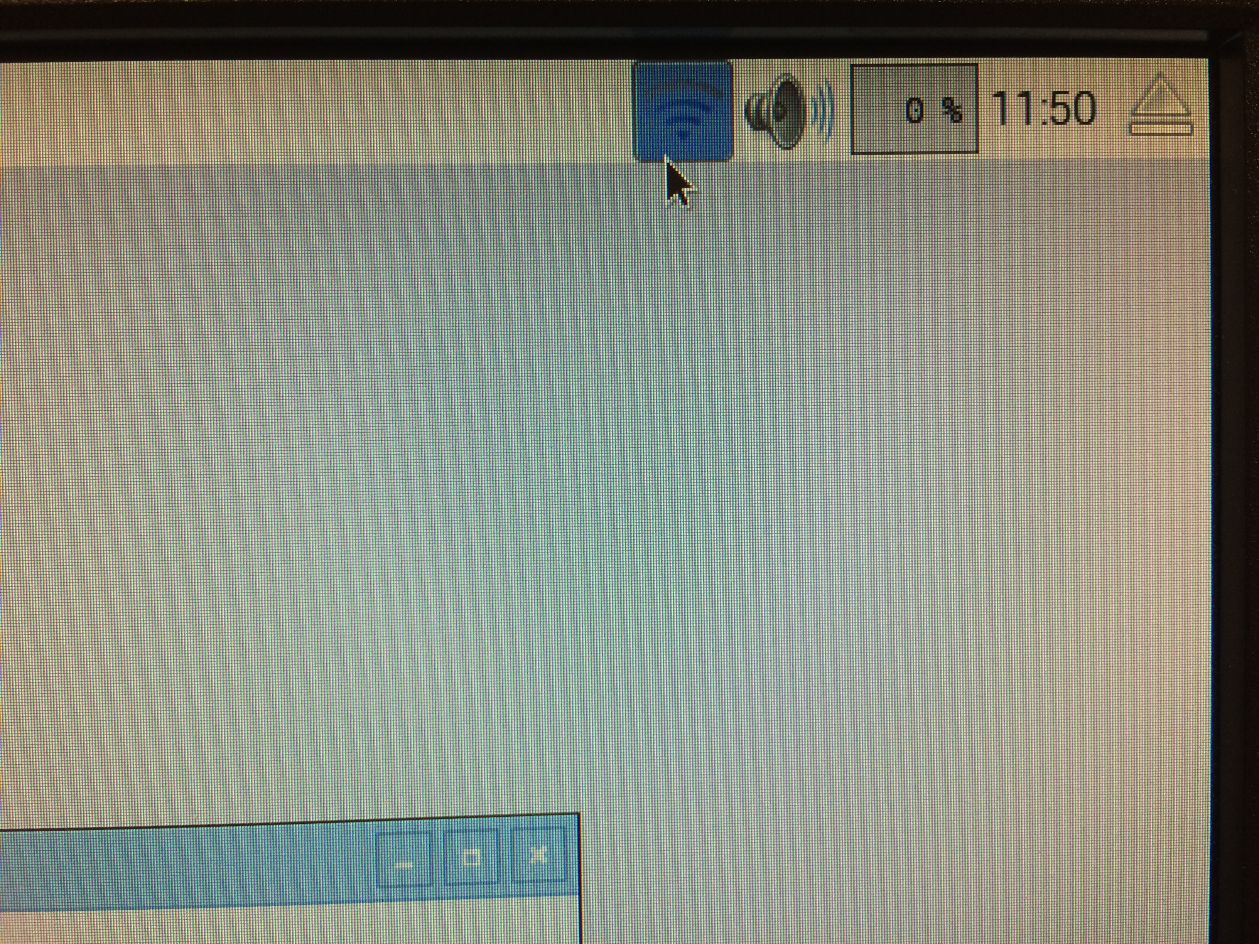
Configure WiFi - 1
Right-click WiFi Icon to reach network preferences

Slide 21
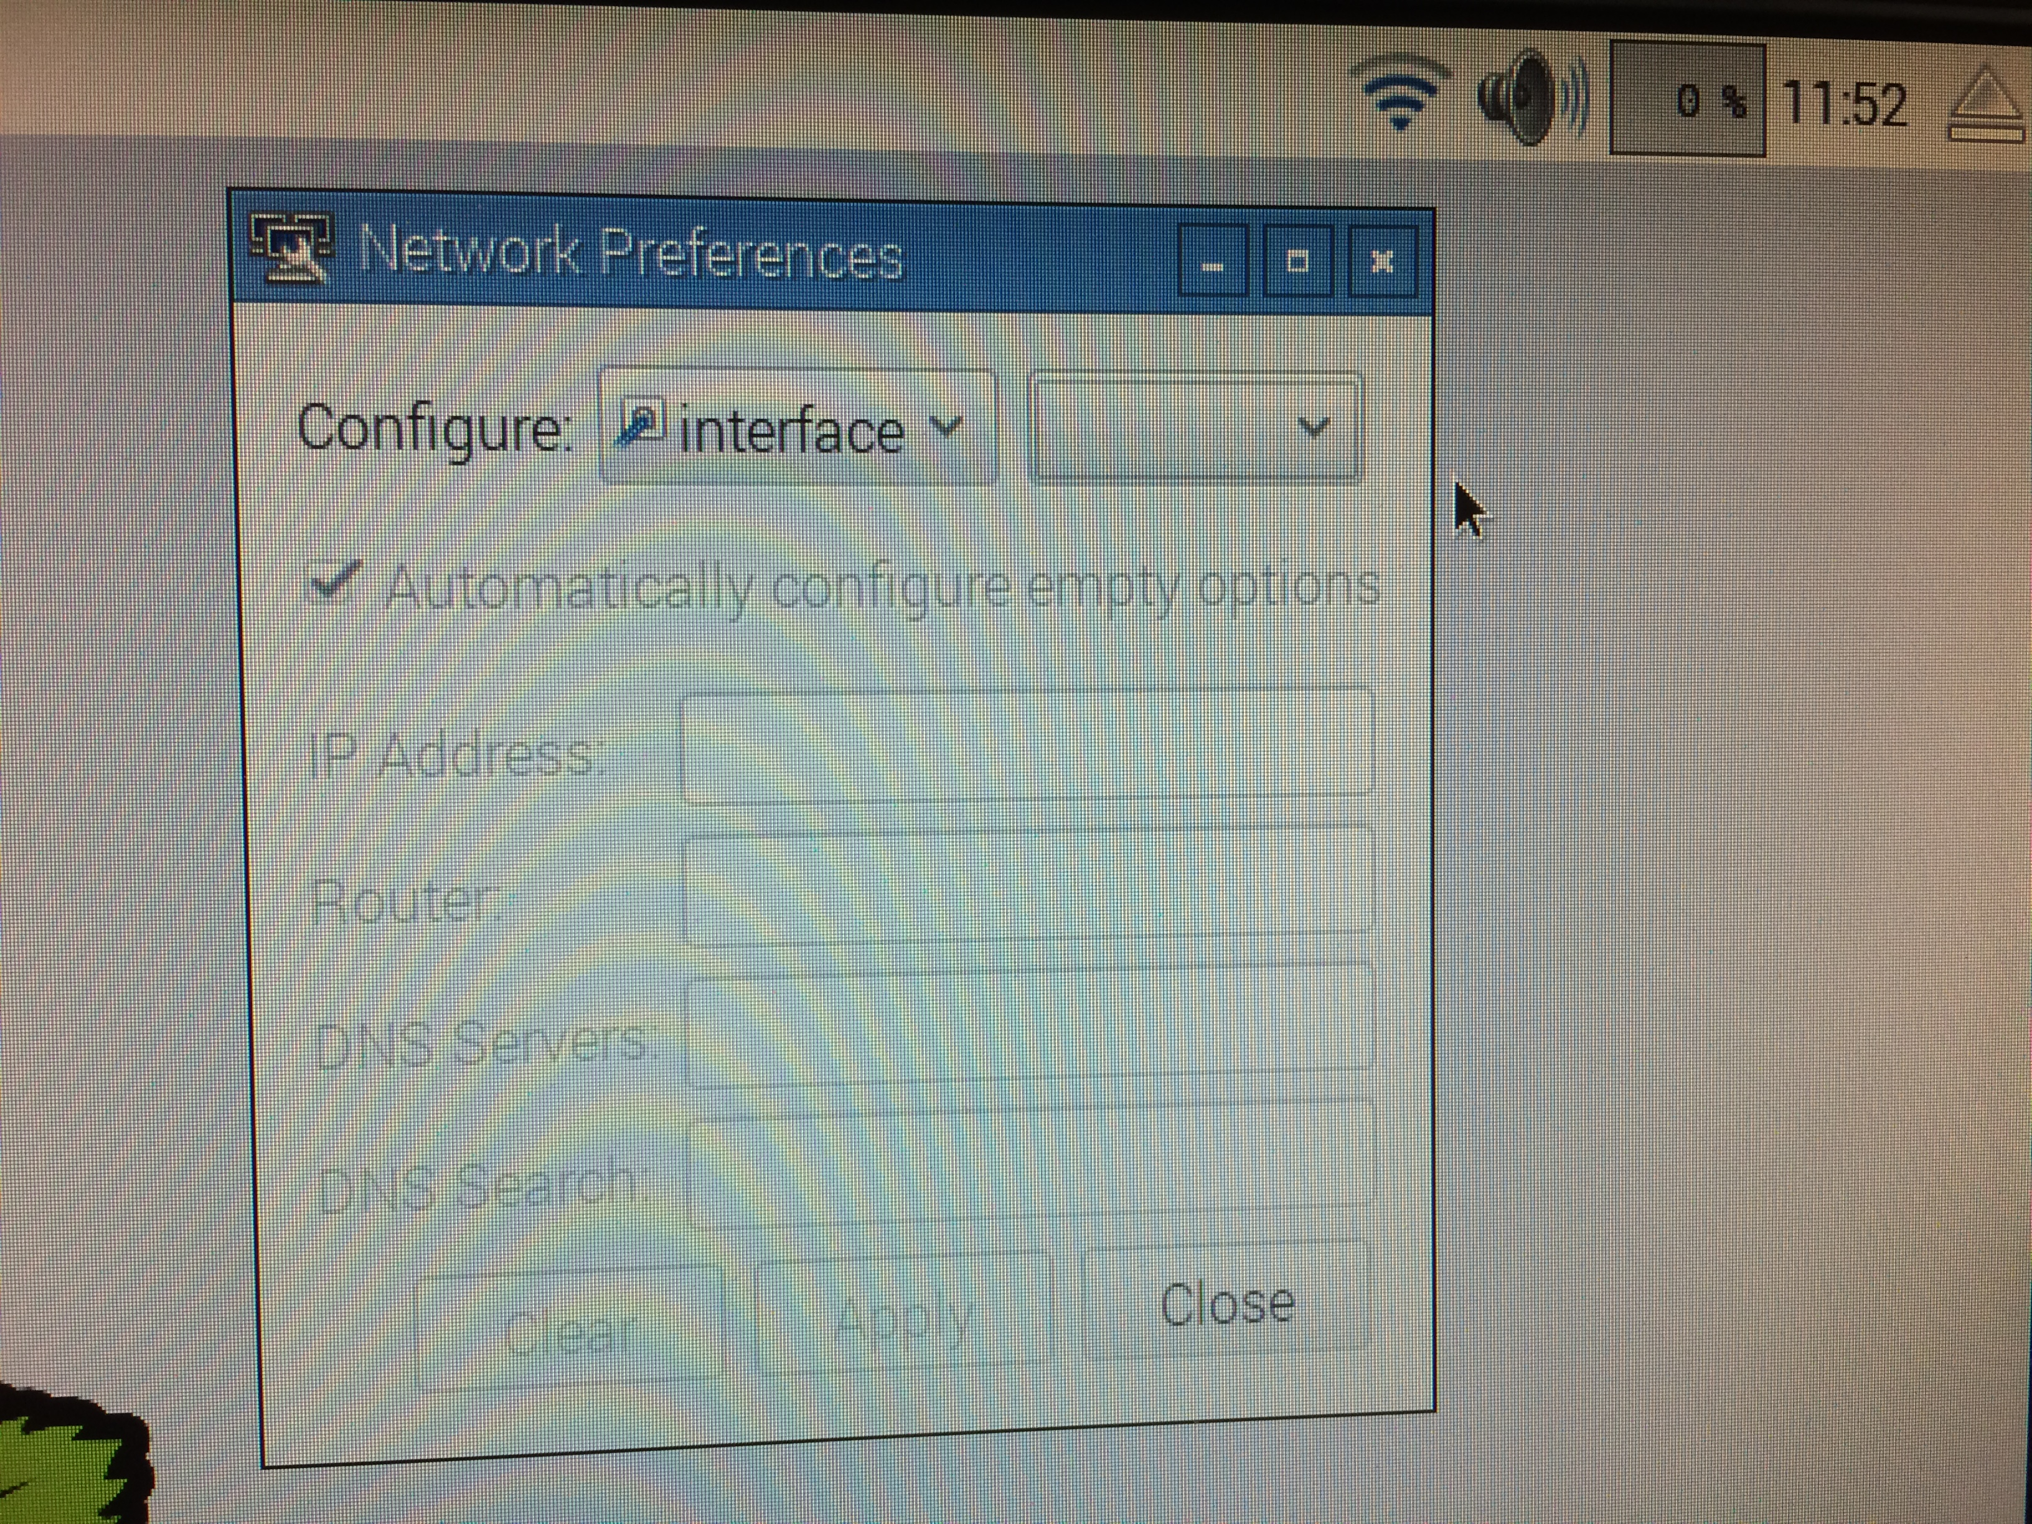
Configure WiFi - 2
Select an interface and enter network parameters

Slide 22
Update Raspbian OS
To update the Raspberry Pi software, use the following commands in your terminal window to apply any outstanding Raspbian OS patches and upgrades
sudo apt-get update
sudo apt-get upgrade

Slide 23
Determine IP Address of Raspberry Pi
Use terminal window to determine the IP address of your Raspberry Pi
Be sure to retain this information for later
ifconfig

Slide 24
OpenPLC Installation on Raspberry Pi 3 B+

Slide 25
Installing OpenPLC Runtime on Pi
Browse to OpenPLC Project and follow provided instructions to install OpenPLC
https://www.openplcproject.com/getting-started-rpi
Install Git
sudo apt-get install git
Clone OpenPLC repository (I download the ZIP file directly from GitHub)
git clone https://github.com/thiagoralves/OpenPLC_v3.git
Change directory into repository clone
cd OpenPLC_v3
Run install script
./install.sh rpi
Test OpenPLC installation by browsing to the following URL
Pi_IP_Address_Goes_Here:8080

Slide 26
Sample OpenPLC – Raspberry Pi Project

Slide 27
Circuit Schematic
+V
PB1
%IX0.2
%QX0.0
OpenPLC Raspberry Pi
R1
R3
%IX0.3
LED1
PB2
R2
Ground
+V is 3.3Volts for the Raspberry Pi
PB1 and PB2 are momentary pushbuttons
R1 = R2 = R3 = 1 k Ohm resistor
LED1 is a light emitting diode (LED)

Slide 28
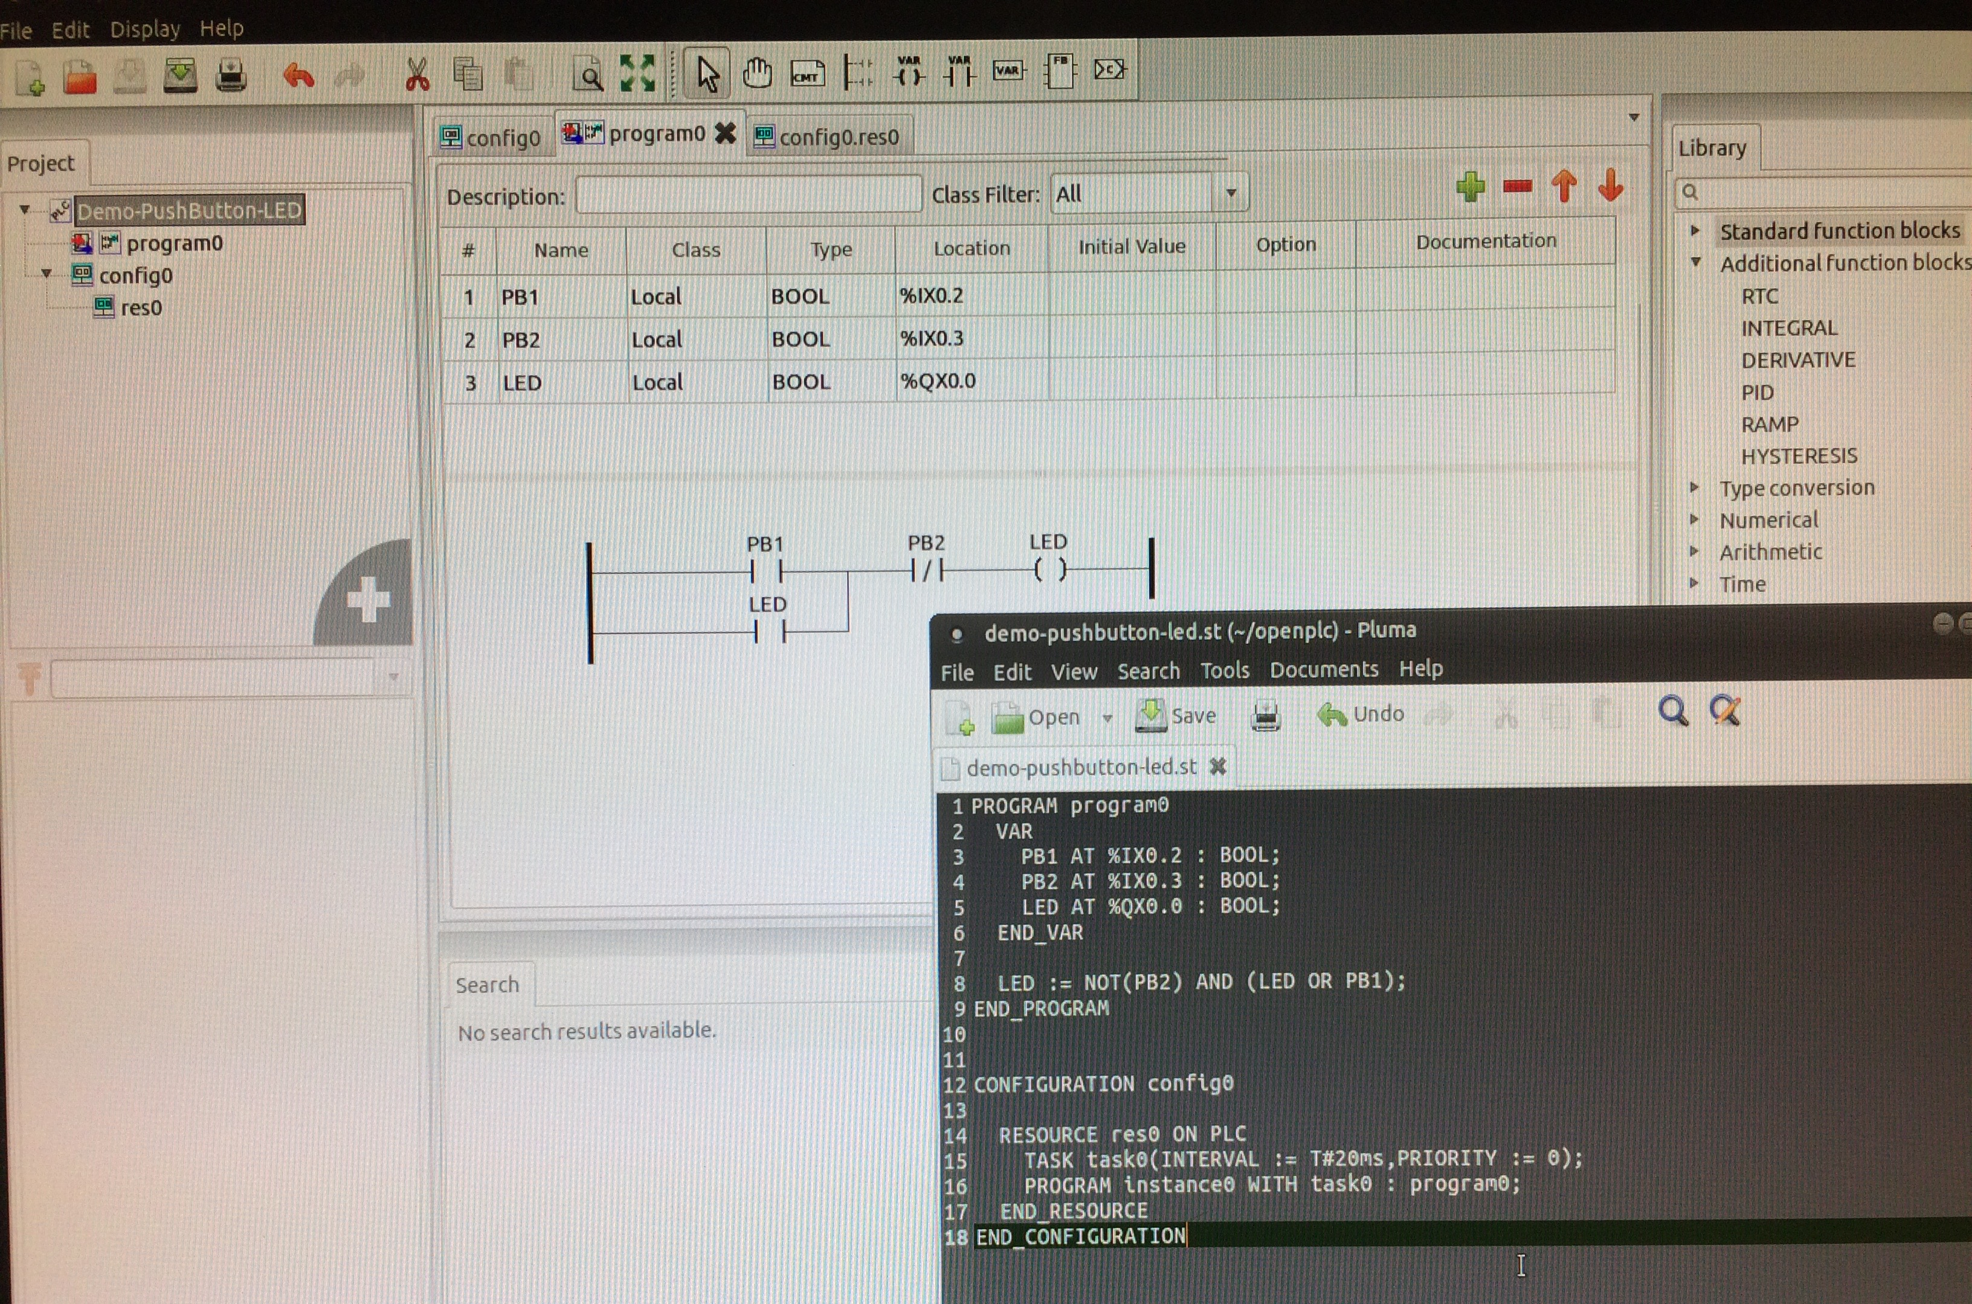
Ladder Logic and Generated Structured Text

Slide 29
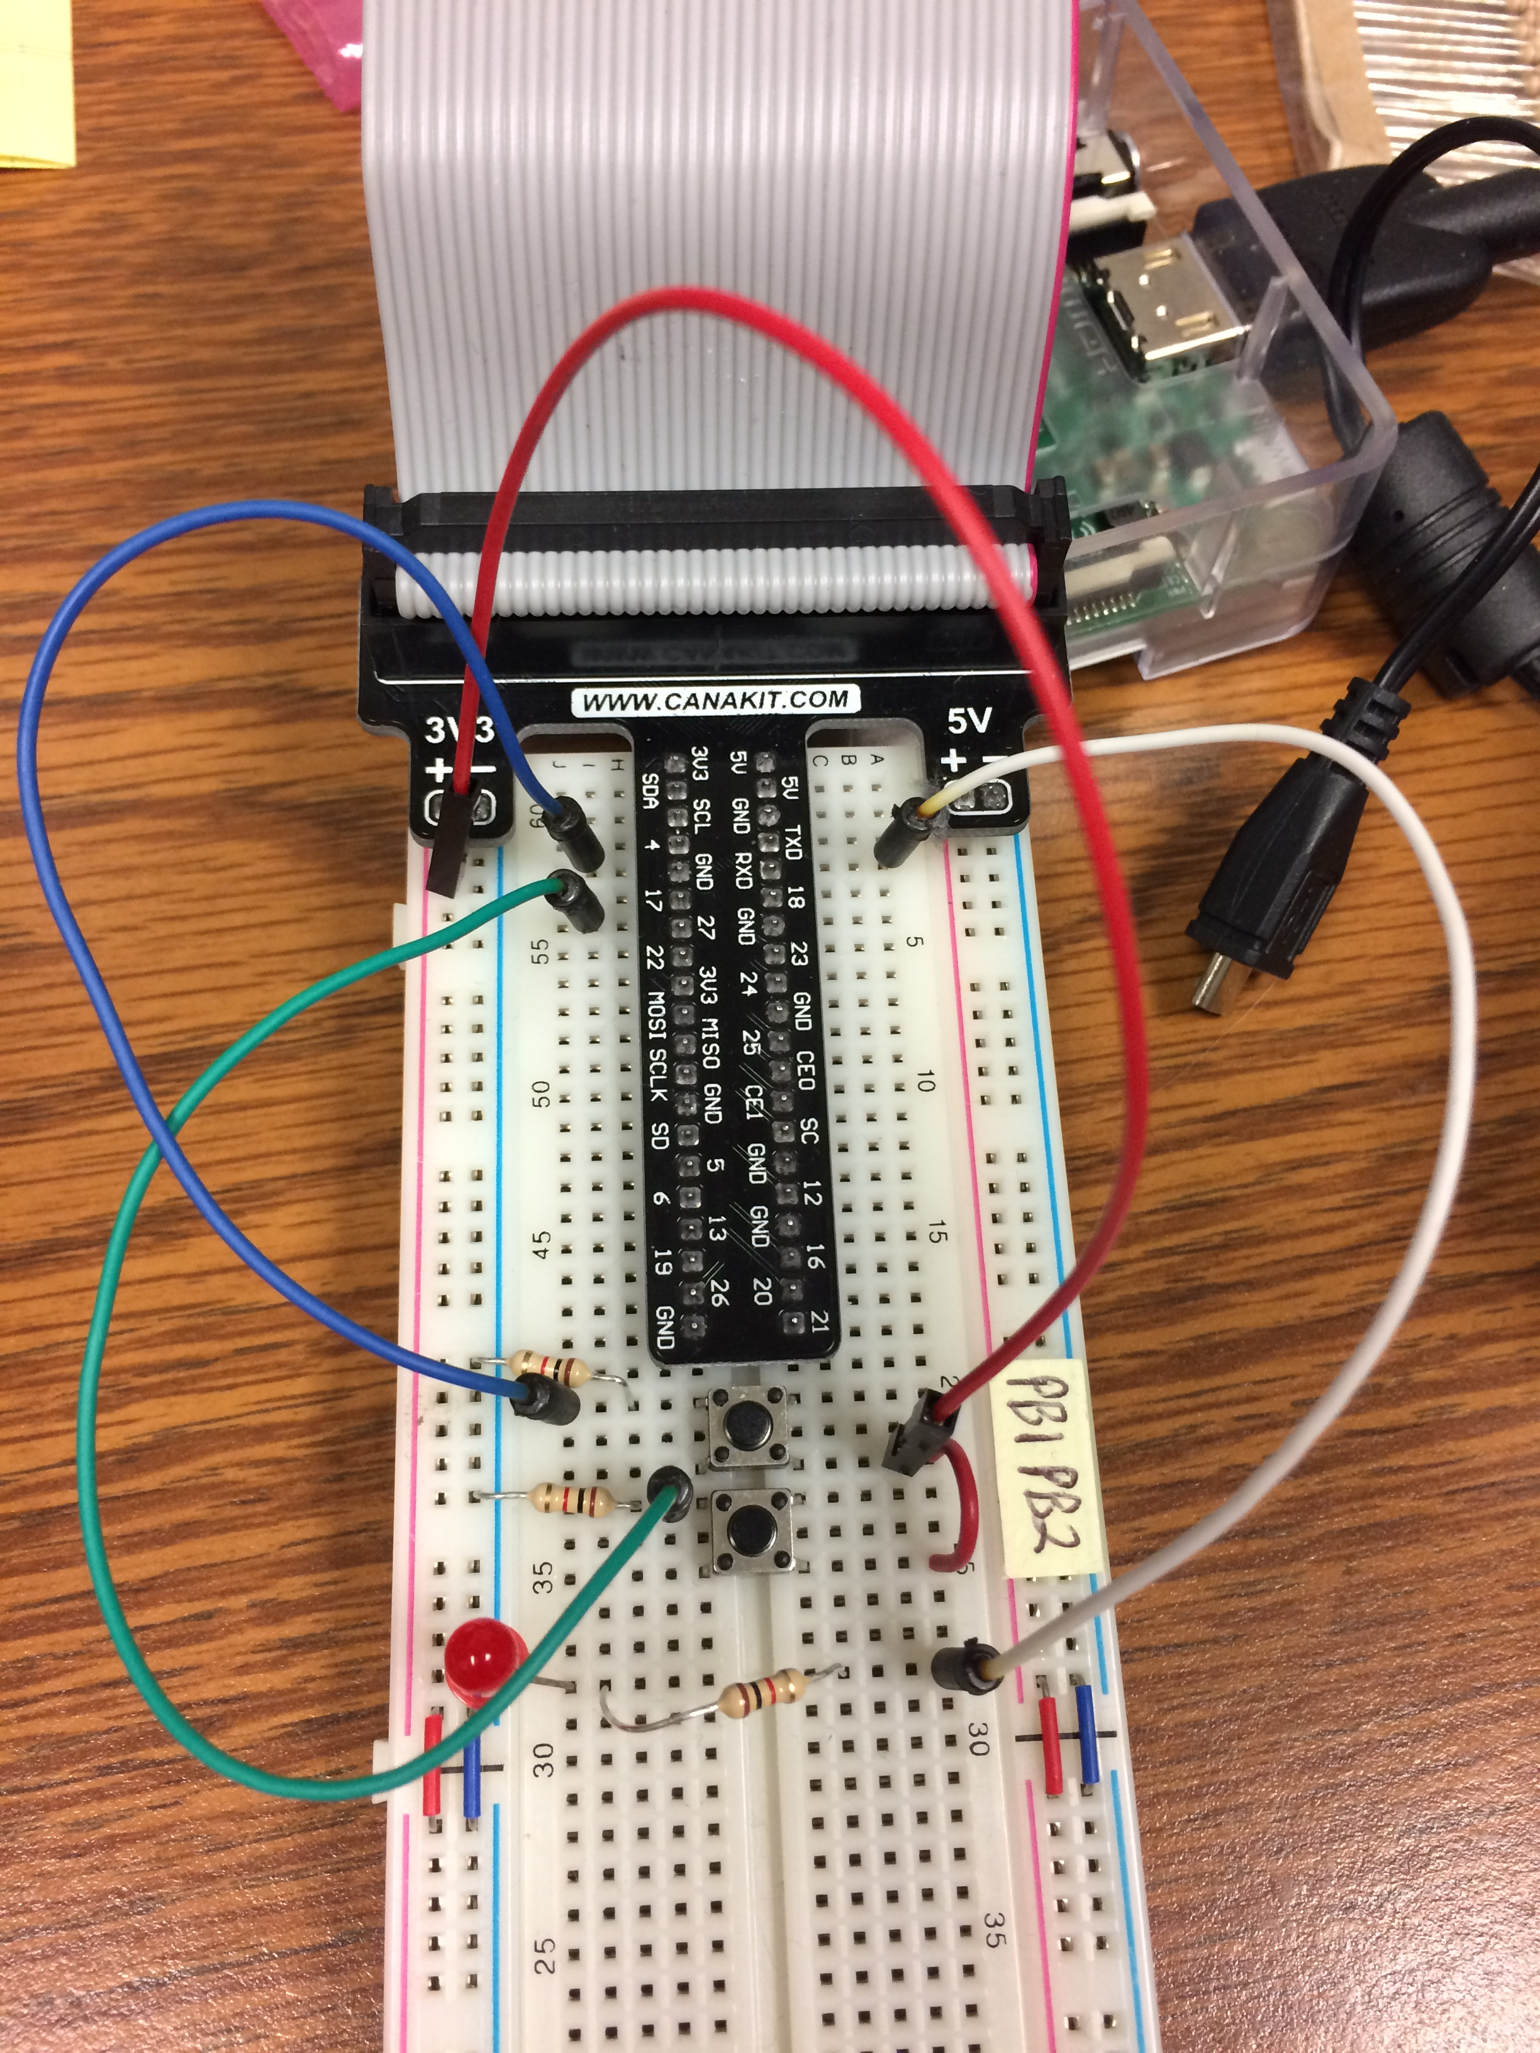
Layout of Physical Circuit on Breadboard

Slide 30
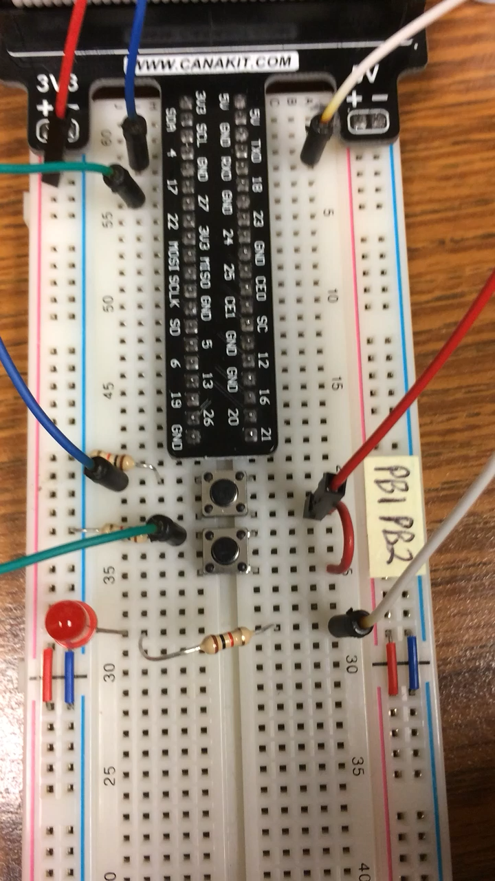
Ladder Logic and Generated Structured Text
%IX0.2
%QX0.0
%IX0.3
https://www.openplcproject.com/getting-started-rpi

Slide 31
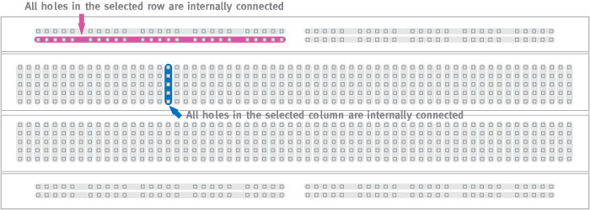
Circuit Components – Prototyping Breadboards
http://wiring.org.co/learning/tutorials/breadboard/

Slide 32
Cyber-Physical Systems: Circuit Hints
Breadboard your circuit before powering up the Raspberry Pi
Check it carefully before applying power
Double check against the pinout diagrams
Be mindful of component voltage levels
Some may be 5V, others 3.3V
Routing 5V into a 3.3V device is usually bad
Level translation may be required
Learn to interpret the component datasheets
Look at min/max voltages and currents
May provide sample circuits that illustrate use of a particular component
Invest in a multimeter for measuring voltages, currents, resistance, and continuity

Slide 33
Cyber-Physical Systems: Circuit Hints
Most processor General Purpose Input/Output (GPIO) pins are not designed to drive low impedance/low resistance loads
Relay, solenoid, and motor coils require a driver circuit that can supply more current than the GPIO pins
LEDs typically require a series resistor to limit current draw
Resistor too large allows too little current flow (dim LED)
Resistor too small or non-existent allows too much current flow (bad)
Failure to limit current sourcing/sinking through GPIO pins may result in permanent damage to the Raspberry Pi (or Arduino)
Relay/solenoid coils may require a parallel diode to dissipate back EMF (current flowing from collapsing magnetic field)

Slide 34
Circuit Components – Resistors - 1
I
I
+ V -
+ V -
Ohm’s Law
Voltage = Current x Resistance
V = I x R
Current calculations for 1k ohm resistor with 5 V and 3.3 V circuits
I = V / R = 3.3 volts/1000 ohm = 3.3 milliamps (mA)
I = V / R = 5.0 volts/1000 ohm = 5.0 milliamps (mA)

Slide 35

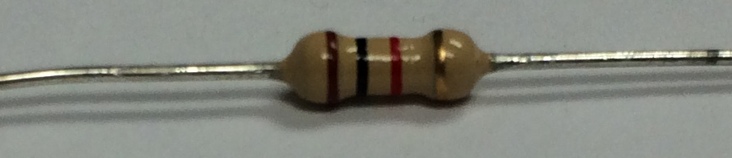
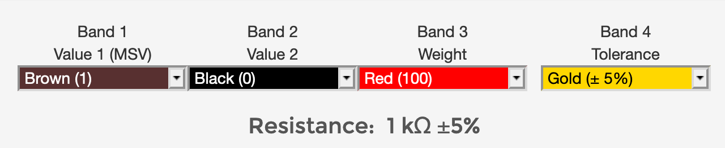
Circuit Components – Resistors - 2
https://sites.google.com/site/kmitl58010166/home/lab-i-basic-resistive-circuit-calculations-and-measurements
Photograph of 1 kOhm resistor
Sample output from online resistance calculator at URL below
https://learn.sparkfun.com/tutorials/resistors

Slide 36
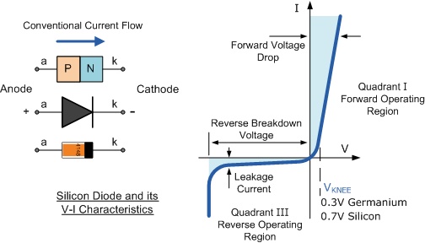
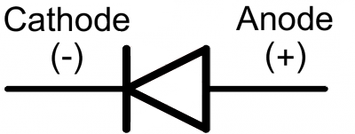
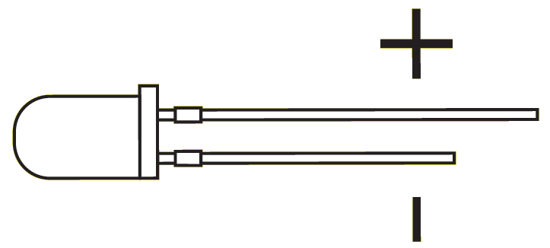
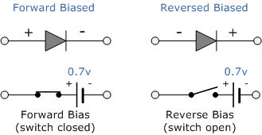
Circuit Components - Diodes
Signal Diode
“one-way current check valve”
Light Emitting Diode (LED)
https://cdn.sparkfun.com/assets/learn_tutorials/7/5/backwardsDiode.png
https://www.electronics-tutorials.ws/diode/diode_4.html

Slide 37
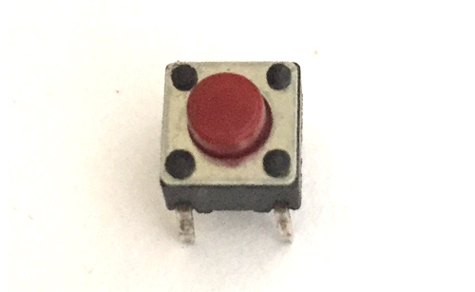
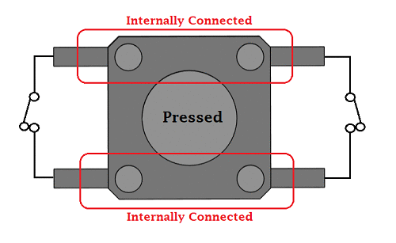
Circuit Components - Pushbuttons
A
A
B
B
A
B
A
B
Switch Open
(Normally Open)
Switch Closed
(Switch Pressed)
https://components101.com/switches/push-button

Slide 38
Hints for Instructors

Slide 39
How are these circuits different?
+V
PB1
PB2
IN
OpenPLC Raspberry Pi
OUT
R2
R1
LED1
+V
PB1
IN
OpenPLC Raspberry Pi
OUT
PB2
R1
R2
LED1
+V
PB1
IN1
OUT
OpenPLC Raspberry Pi
R1
R3
IN2
LED1
PB2
R2

Slide 40
Logical AND Defined by Circuit Geometry
+V
PB1
PB2
IN
OpenPLC Raspberry Pi
OUT
R2
R1
LED1
PB1 | PB2 | IN
Open | Open | 0
Open | Closed | 0
Closed | Open | 0
Closed | Closed | 1
IN = PB1 AND PB2

Slide 41
Logical OR Defined by Circuit Geometry
+V
PB1
IN
OpenPLC Raspberry Pi
OUT
PB2
R1
R2
LED1
PB1 | PB2 | IN
Open | Open | 0
Open | Closed | 1
Closed | Open | 1
Closed | Closed | 1
IN = PB1 OR PB2

Slide 42
Ladder Logic Defines PB1/PB2 Relationship
+V
PB1
IN1
OUT
OpenPLC Raspberry Pi
R1
R3
IN2
LED1
PB2
R2
PB1 | PB2 | IN1 | IN2
Open | Open | 0 | 0
Open | Closed | 0 | 1
Closed | Open | 1 | 0
Closed | Closed | 1 | 1
Build one circuit
Ladder Logic can create AND, OR, XOR, etc.

Slide 43
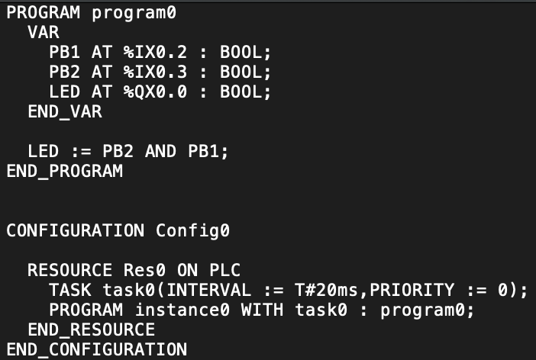
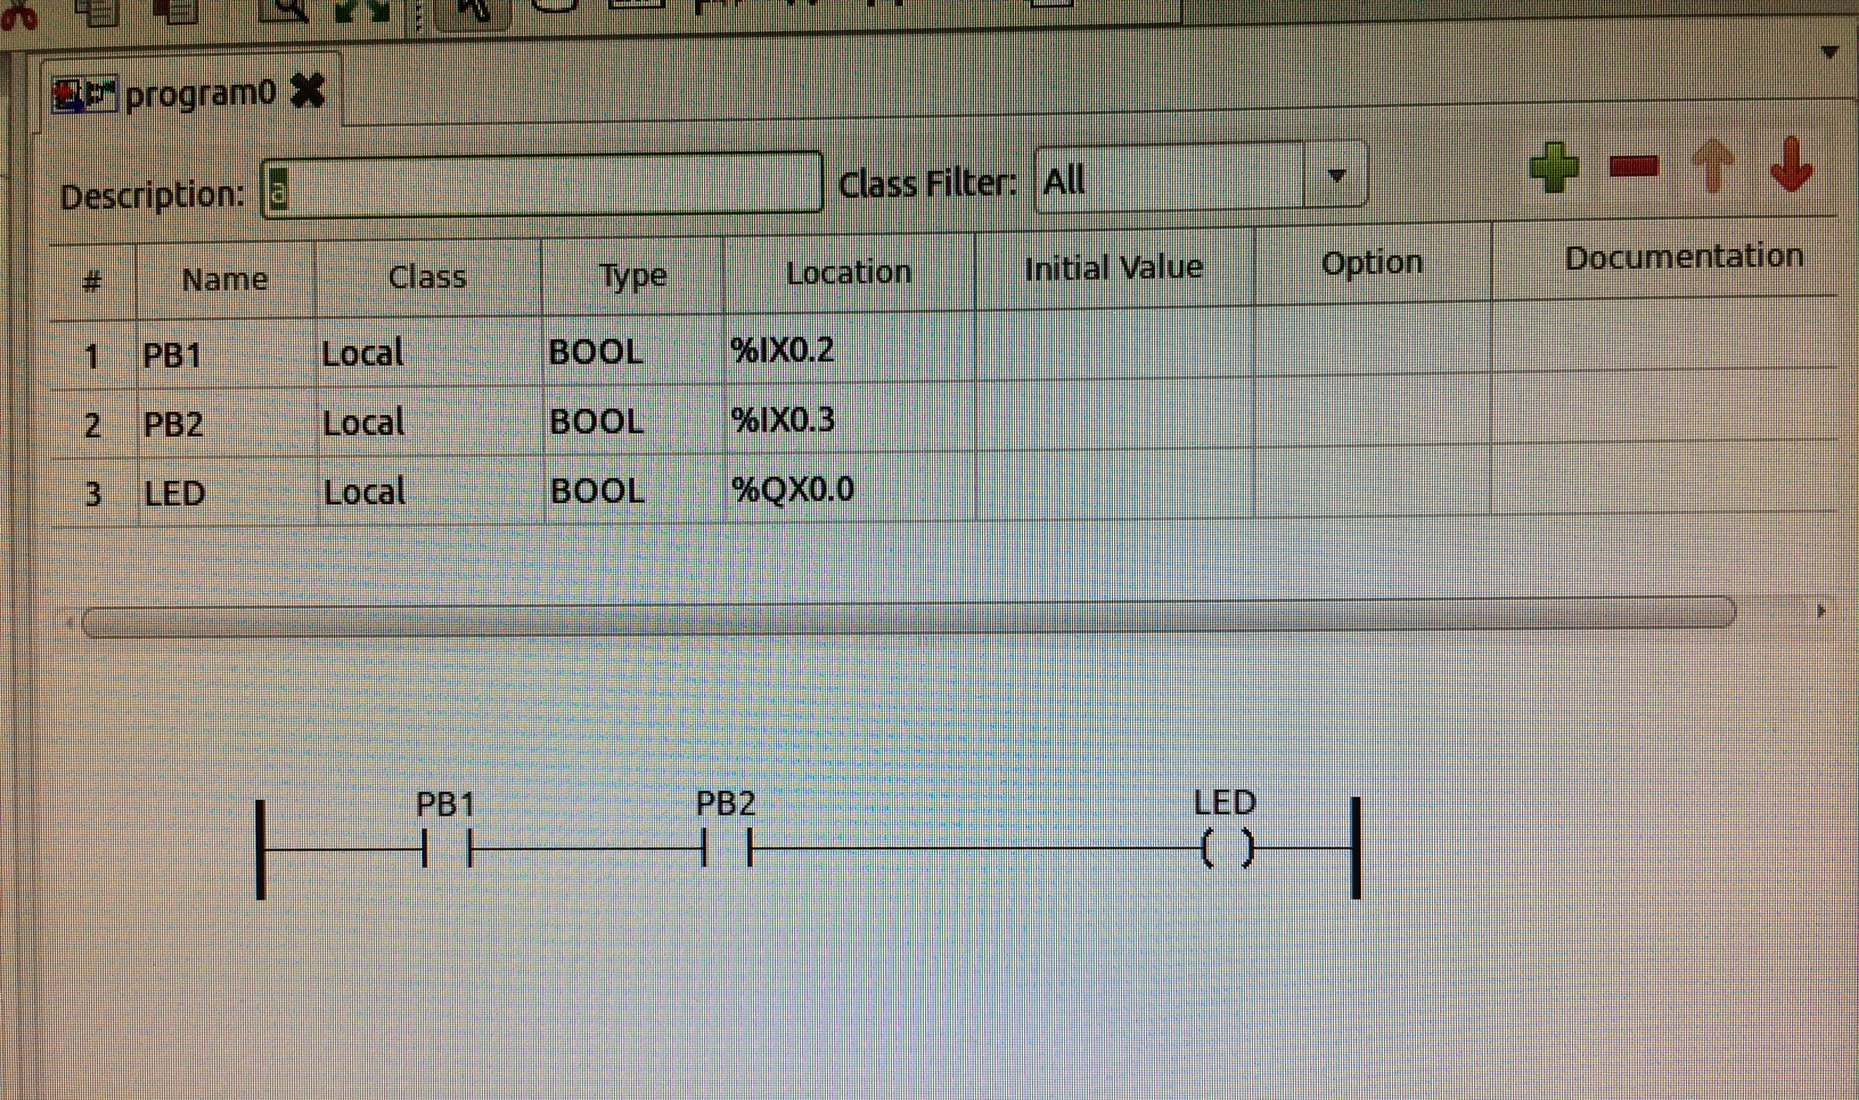
Ladder Logic - Logical AND Operation
+V
PB1
IN1
OUT
Raspberry Pi
R1
R3
IN2
LED1
PB2
R2

Slide 44
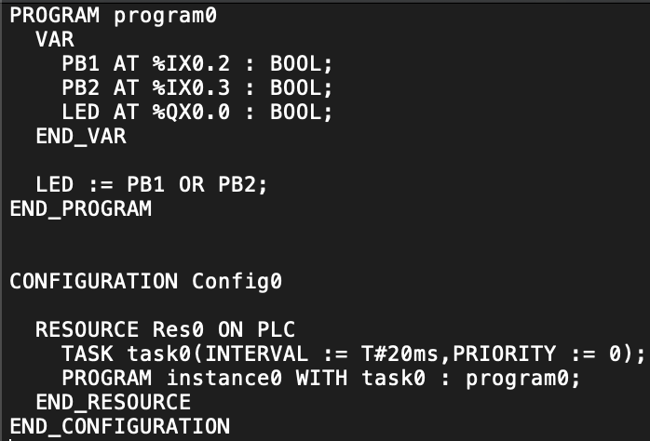
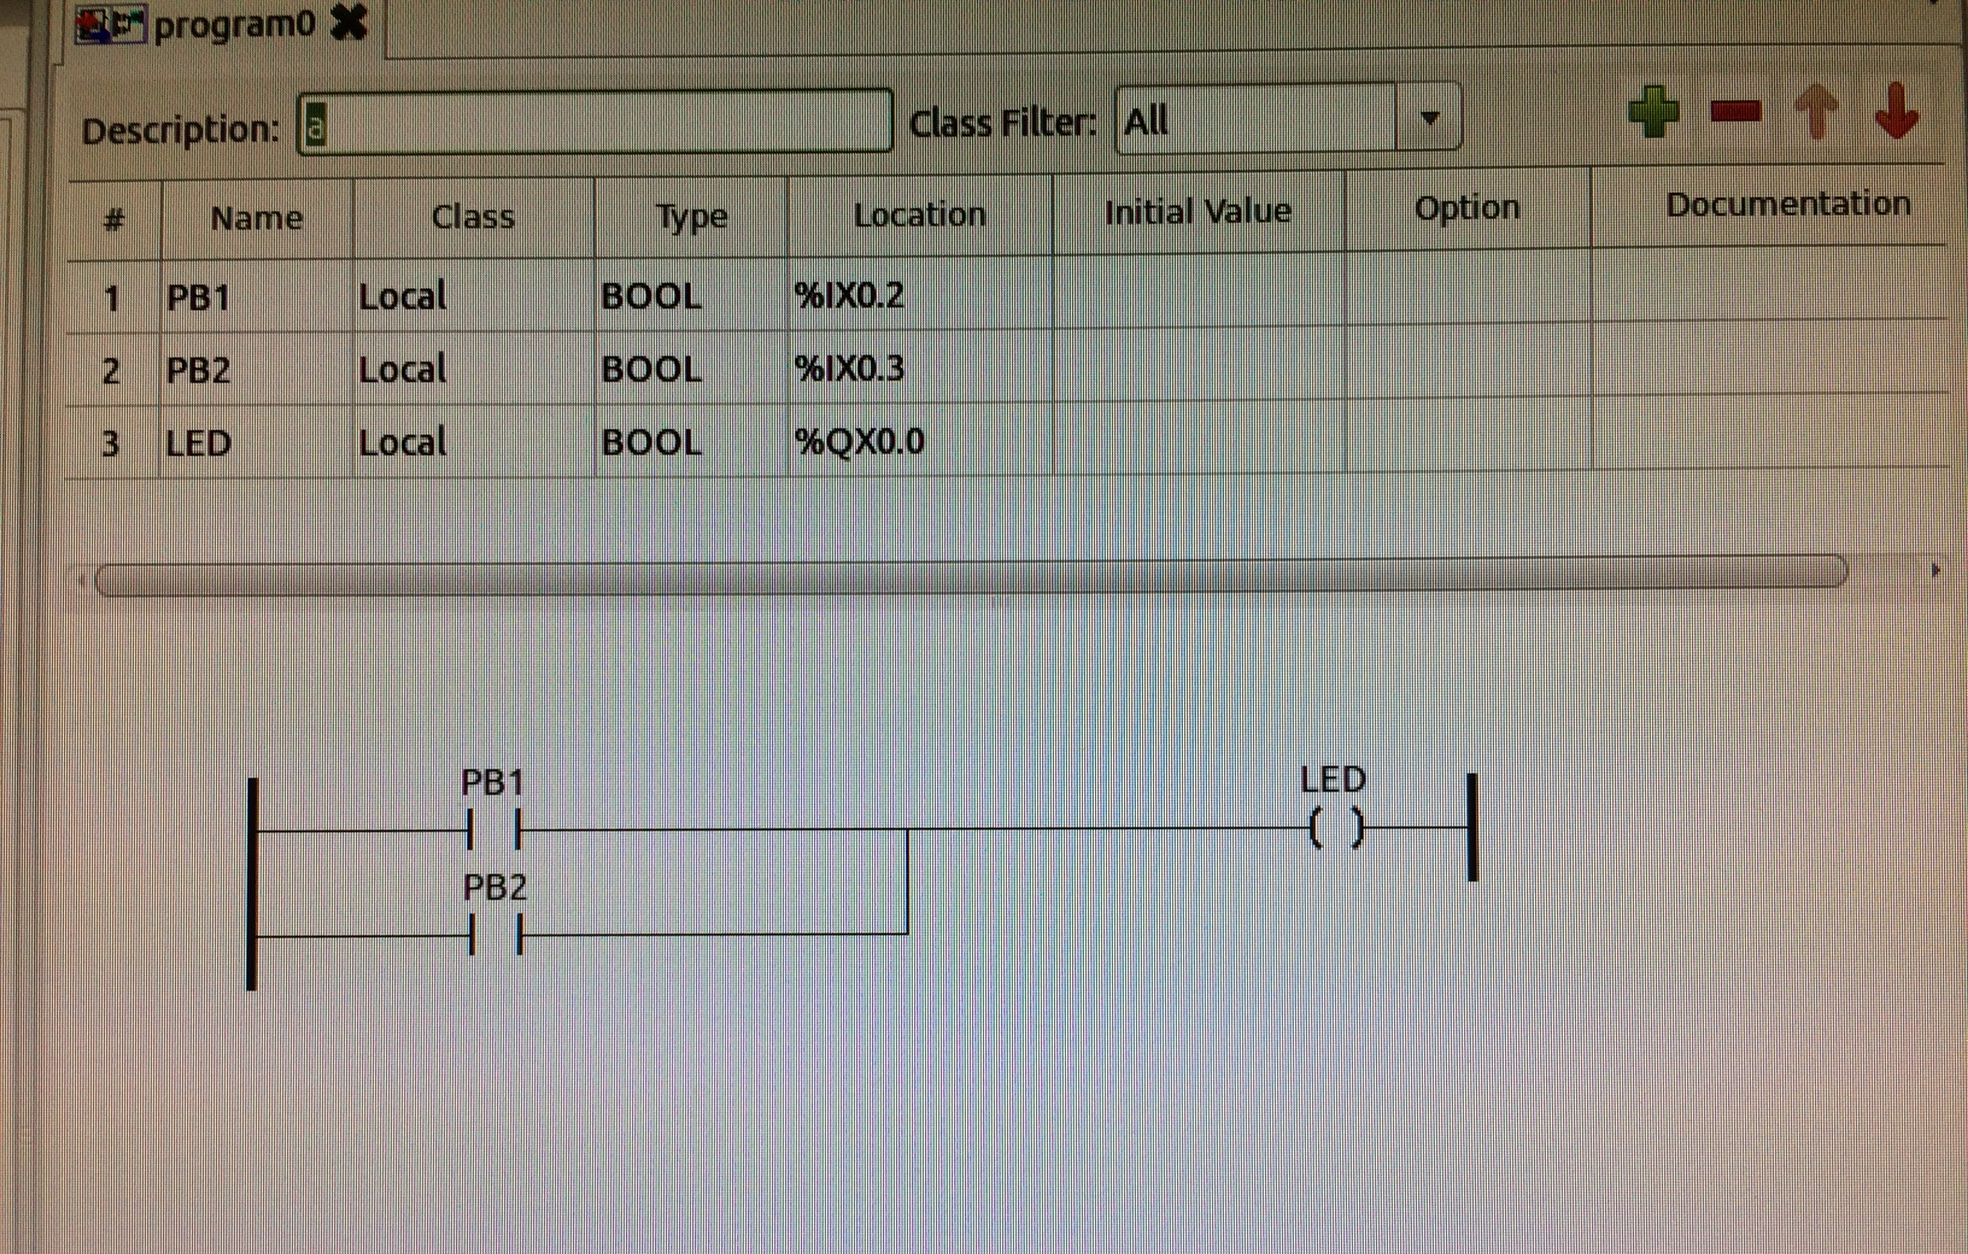
Ladder Logic - Logical OR Operation
+V
PB1
IN1
OUT
Raspberry Pi
R1
R3
IN2
LED1
PB2
R2

Slide 45
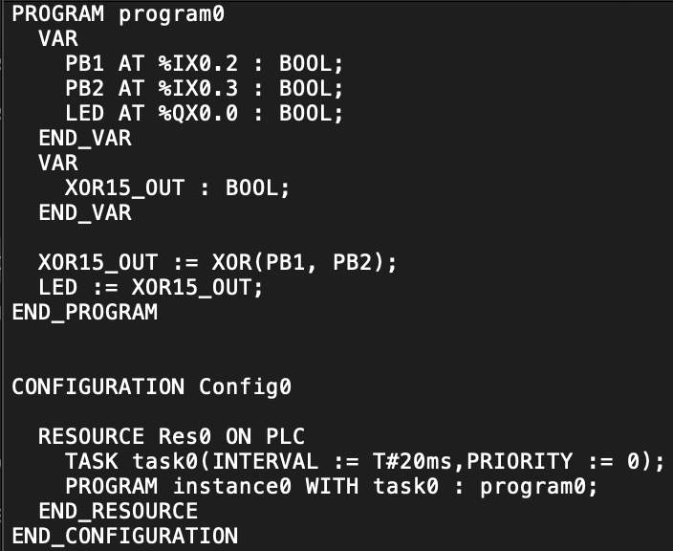
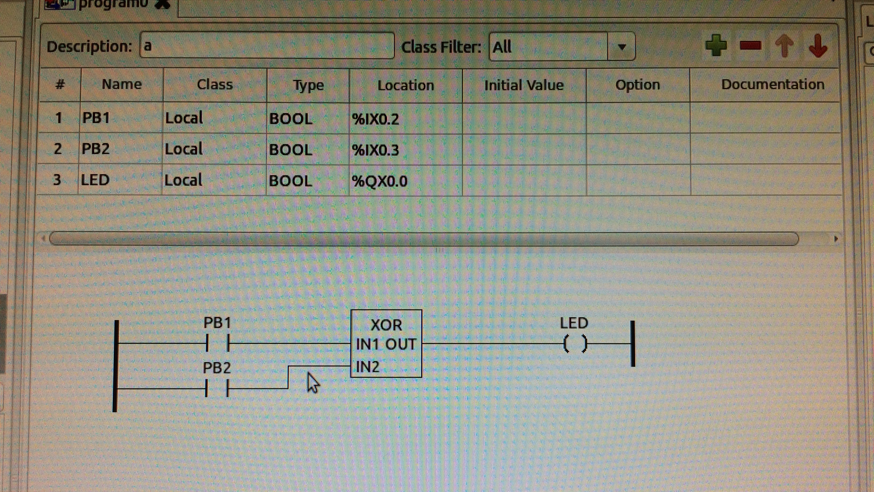
Ladder Logic – XOR Function Block
+V
PB1
IN1
OUT
Raspberry Pi
R1
R3
IN2
LED1
PB2
R2

Slide 46
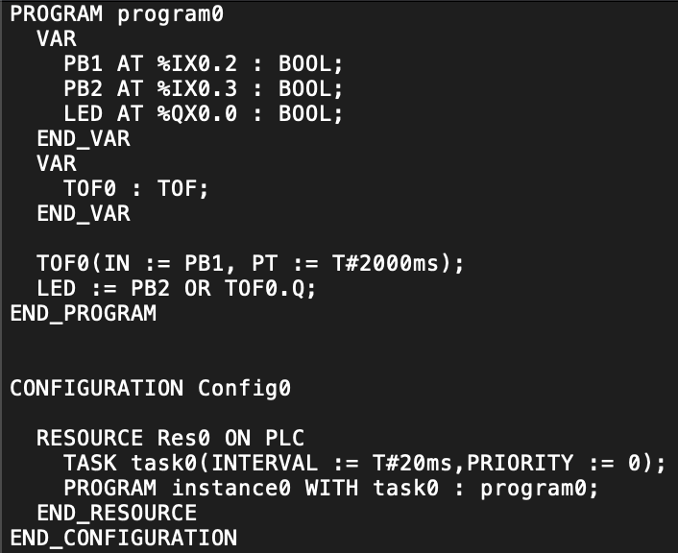
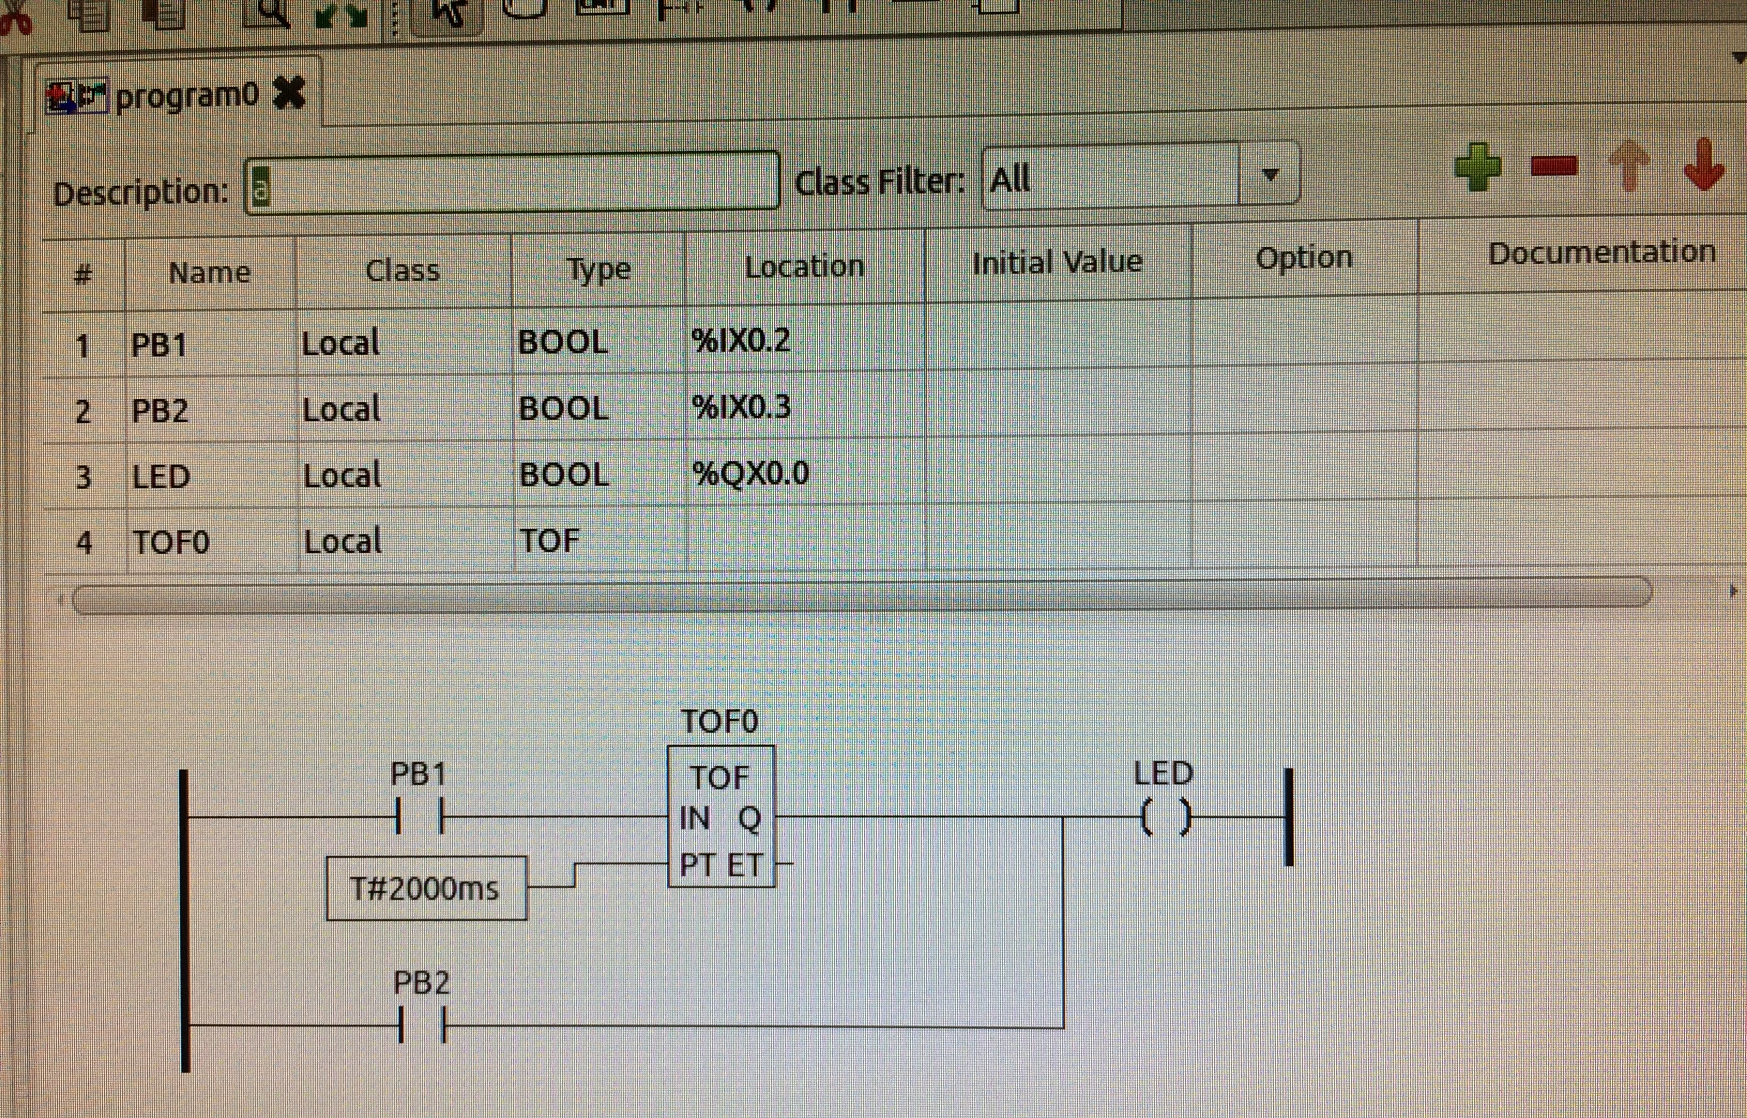
Ladder Logic – Complex Functional Block
+V
PB1
IN1
OUT
Raspberry Pi
R1
R3
IN2
LED1
PB2
R2

Slide 47
References
The OpenPLC Project
https://www.openplcproject.com/
OpenPLC Editor
https://github.com/thiagoralves/OpenPLC_Editor
Horowitz and Hill, The Art of Electronics 2nd ed.
Good overview of digital and analog circuits with many examples including interfacing to sensors and actuators such as those in a cyber-physical system

Slide 48
Hands-On Laboratory Exercise #5

Slide 49
Laboratory Exercise #5 Instructions - 1
Objectives
Practice using the OpenPLC toolchain (OpenPLC editor, OpenPLC runtime, and ScadaBR) to implement and test the alternative ladder logic programs

Slide 50
Laboratory Exercise #5 Instructions - 2
Implement and test the alternative ladder logics presented in this lecture for the First Project physical circuit
PB1 AND PB2
PB1 OR PB2
PB1 XOR PB2
PB1 (with 2 sec dwell ON) OR PB2
https://www.openplcproject.com/reference-your-first-project

Slide 51
Laboratory Exercise #4 Instructions - 3
Demonstrate HMI operation by replicating all possible push button states (as previously done with the simulator) but this time you will be using the physical circuit buttons for all ladder logics implemented
https://www.openplcproject.com/reference-your-first-project

Slide 52
Laboratory Exercise #5 Instructions - 4
Sample Deliverables
Zip file of entire project directory including structured text code
Screenshots of Ladder Logic implemented and generated structured text
Screenshots of HMI output for each possible combination of input states

